Slide 1


Social Media Guidelines and Best Practices for ASHRAE Groups
Enhancing Your Online Presence
Provided by ASHRAE Communications Committee
Created 2018, Revised 2024
Notes:
1

Slide 2

Disclaimer
This presentation is maintained by the Communications Committee of ASHRAE. It does not present official positions of the Society, nor reflect Society policy. The Communications Committee may not act for the Society and the information presented here has not had Society review. To learn more about ASHRAE activities on an international level, visit ashrae.org.
This presentation lists the most commonly used commercial names of Social Media platforms as examples only. There are many other Social Media websites currently available that are not listed. Neither ASHRAE, nor the presenter represent, endorse, or promote any of these platforms.
Notes:
2

Slide 3

Objective
The purpose of this presentation is to serve as a comprehensive resource for using social media in your organization.
This presentation is NOT meant to be viewed or delivered in its entirety. Consider each section its own mini-presentation!
Use the hyperlinks to jump to the relevant sections for your organization’s needs
Notes:
3

Slide 4
Social Media Basics
Notes:
5

Slide 5
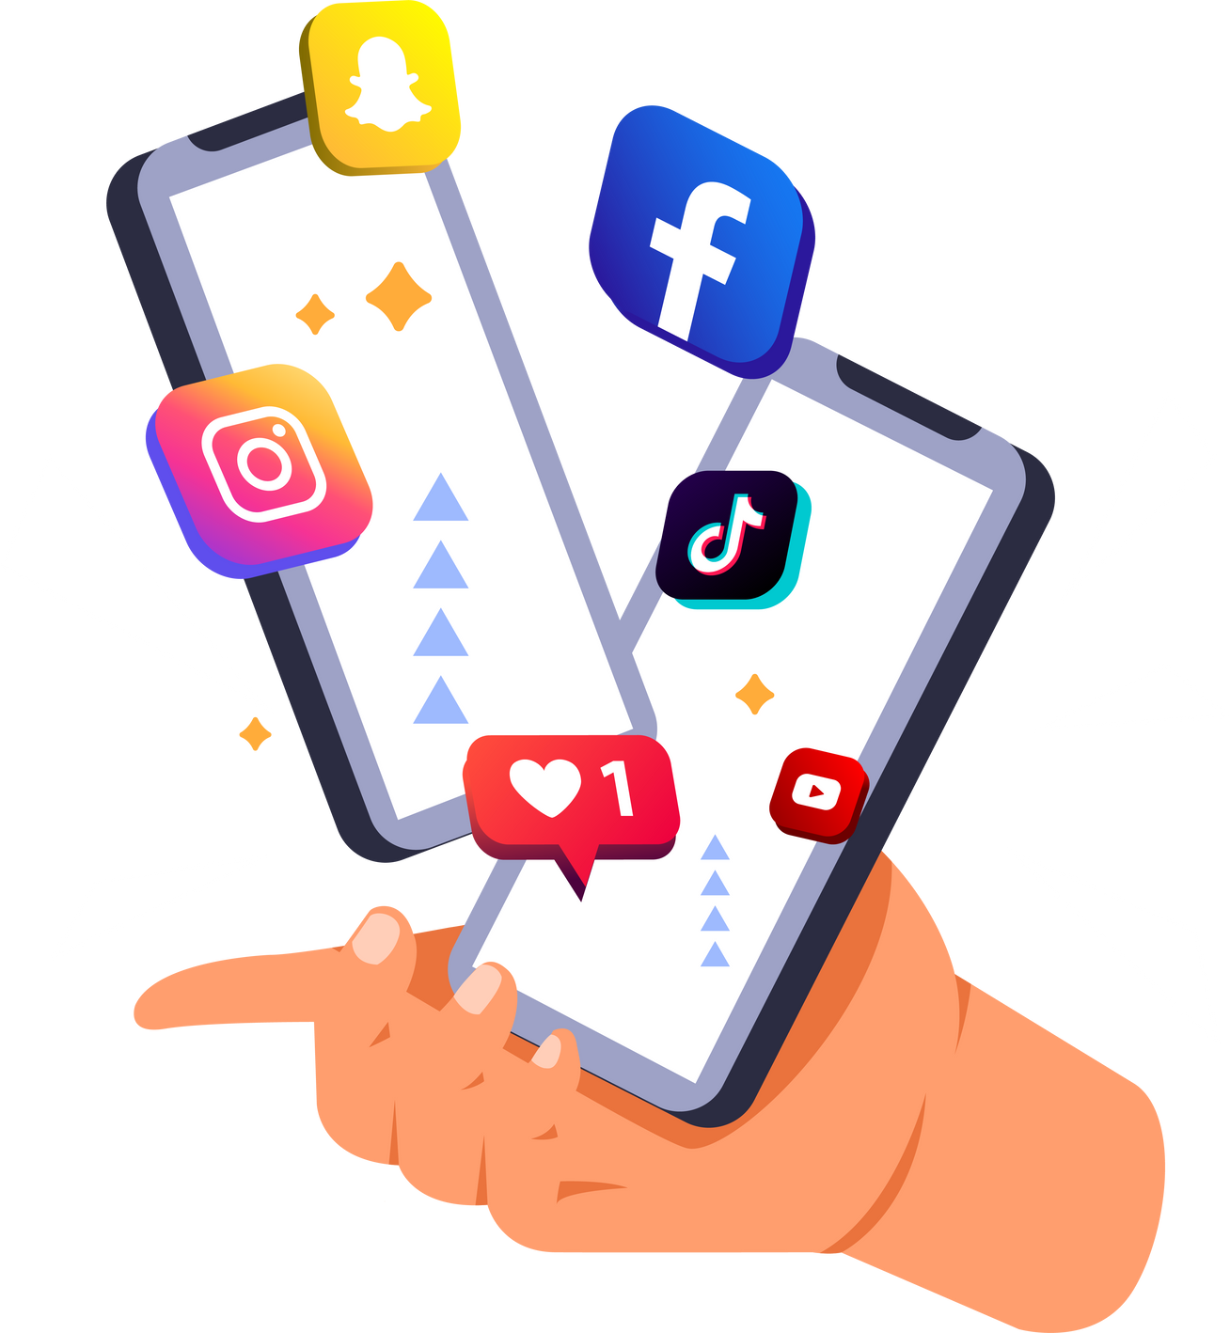
What is Social Media?
Social media is an online platform that enables people to create, share, and interact with content and connect with others globally.
In 2023, an estimated 4.9 billion people use social media across the world
The number of social media users worldwide has swelled to a record 4.9 billion people globally. What’s more, this number is expected to jump to approximately 5.85 billion users by 2027.
These aren’t users tied to a single platform, either: The average user now spreads their digital footprint across a staggering six to seven platforms every month—highlighting the need for a multi-platform approach to social media marketing.
Source: https://www.forbes.com/advisor/in/business/social-media-statistics/
Notes:
With 1 billion Facebook users, 340 million active Twitter users and 370 more apps, again, this is NOT just a fad!! I would strongly suggest to jump on the train sooner than later.
Who has a personal FB account? Who uses it? Why do you use it?
Who has a personal twitter account? Who uses it? Do you know how to use it?
Who is on Linkedin? Who has its company or the company they worked for on Linkedin? Who uses it?
6

Slide 6
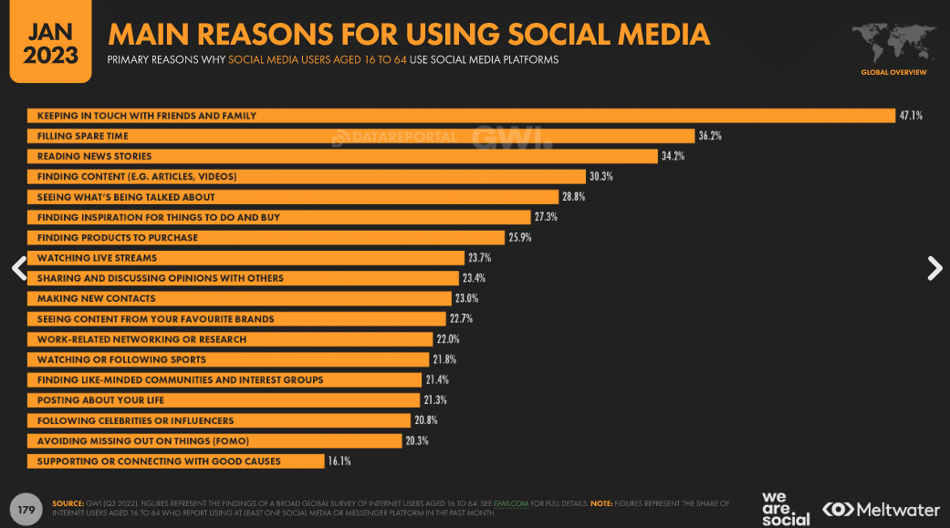
Why Social Media?
Image Source: https://blog.hootsuite.com/social-media-for-nonprofits/
Notes:
With 1 billion Facebook users, 340 million active Twitter users and 370 more apps, again, this is NOT just a fad!! I would strongly suggest to jump on the train sooner than later.
Who has a personal FB account? Who uses it? Why do you use it?
Who has a personal twitter account? Who uses it? Do you know how to use it?
Who is on Linkedin? Who has its company or the company they worked for on Linkedin? Who uses it?
6

Slide 7
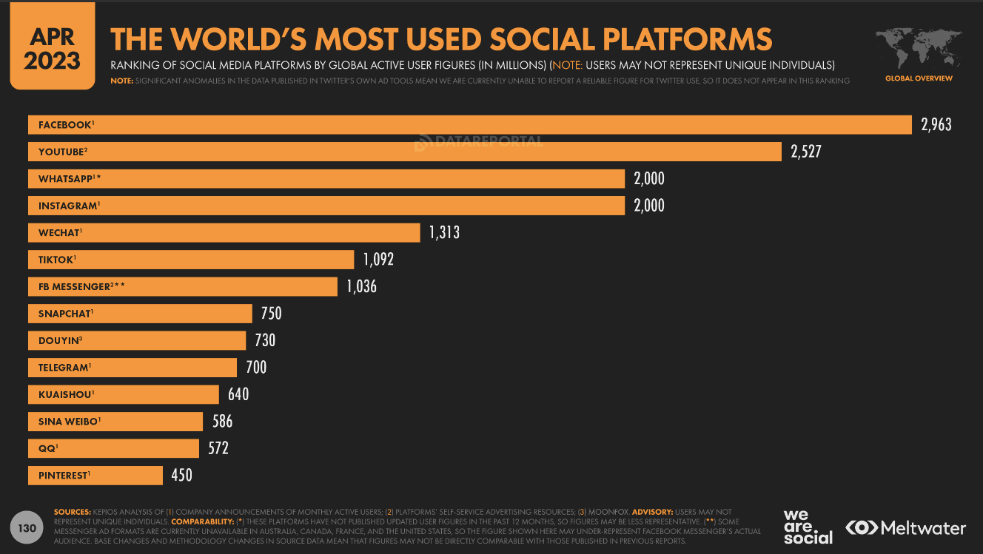
Social Media Platform and its users
Image Source: https://www.smartinsights.com/social-media-marketing/social-media-strategy/new-global-social-media-research/
Notes:
With 1 billion Facebook users, 340 million active Twitter users and 370 more apps, again, this is NOT just a fad!! I would strongly suggest to jump on the train sooner than later.
Who has a personal FB account? Who uses it? Why do you use it?
Who has a personal twitter account? Who uses it? Do you know how to use it?
Who is on Linkedin? Who has its company or the company they worked for on Linkedin? Who uses it?
6

Slide 8
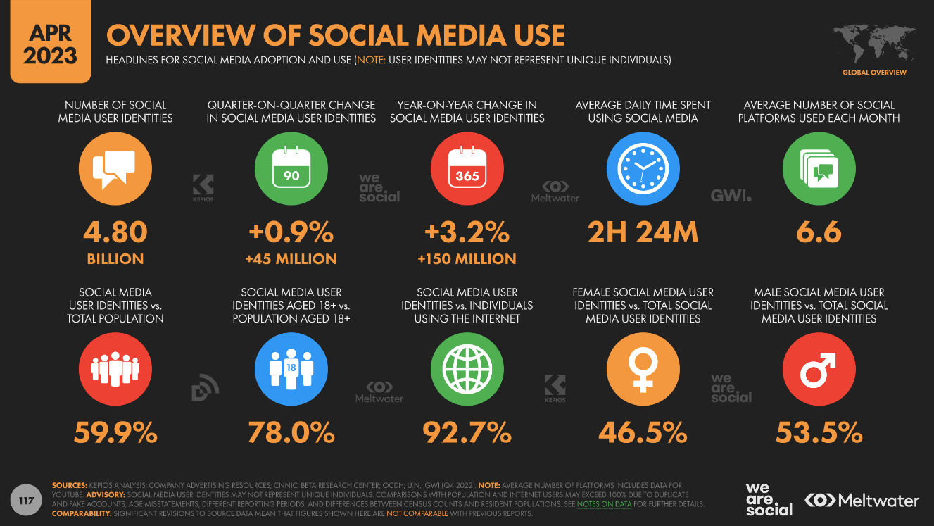
Overview of Social Media Use
Image Source: https://www.smartinsights.com/social-media-marketing/social-media-strategy/new-global-social-media-research/
Notes:
With 1 billion Facebook users, 340 million active Twitter users and 370 more apps, again, this is NOT just a fad!! I would strongly suggest to jump on the train sooner than later.
Who has a personal FB account? Who uses it? Why do you use it?
Who has a personal twitter account? Who uses it? Do you know how to use it?
Who is on Linkedin? Who has its company or the company they worked for on Linkedin? Who uses it?
6

Slide 9


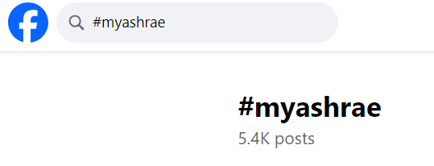

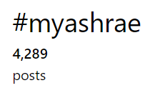
Importance of #Hashtag
Hashtags are important on social media because they help categorize and organize content, making it discoverable by a wider audience. They enhance content visibility, increase engagement, and facilitate trends and discussions.
#myashrae is an example of a hashtag. The right image shows how to search using hashtags on social media platforms
Notes:
With 1 billion Facebook users, 340 million active Twitter users and 370 more apps, again, this is NOT just a fad!! I would strongly suggest to jump on the train sooner than later.
Who has a personal FB account? Who uses it? Why do you use it?
Who has a personal twitter account? Who uses it? Do you know how to use it?
Who is on Linkedin? Who has its company or the company they worked for on Linkedin? Who uses it?
6

Slide 10
Account Nomenclature
Facebook/Instagram/X
Name: This is your display name (ASHRAE).
Username: This is your one-of-a-kind handle. It appears after an @ sign in your Facebook profile/page (@ASHRAEupdates) and in the associated URL (https://www.facebook.com/ASHRAEupdates/)
LinkedIn/YouTube
LinkedIn and YouTube will prompt you to login using a phone number or email address. From there, you can edit your display name, so it reflects your brand name.
Notes:
12

Slide 11
Types of Social Media
Notes:
13

Slide 12
Social Media Networks
  Facebook
  Instagram
  LinkedIn
  X
  YouTube
  Whatsapp
  Pinterest
  Snapchat
And More!
Notes:
Presenter should be prepared to talk about the differences between these social media venues.
14

Slide 13
ASHRAE Presence on Social Media
Notes:
13

Slide 14
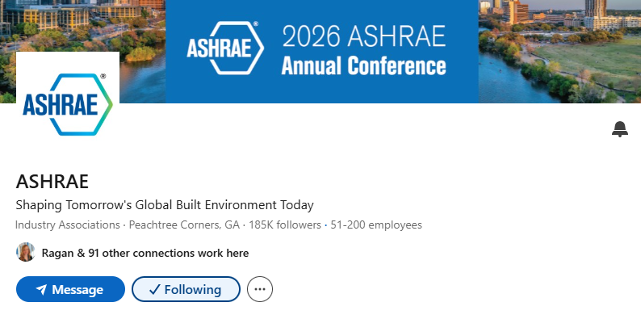
LinkedIn
https://www.linkedin.com/company/ashrae/
Notes:
With 1 billion Facebook users, 340 million active Twitter users and 370 more apps, again, this is NOT just a fad!! I would strongly suggest to jump on the train sooner than later.
Who has a personal FB account? Who uses it? Why do you use it?
Who has a personal twitter account? Who uses it? Do you know how to use it?
Who is on Linkedin? Who has its company or the company they worked for on Linkedin? Who uses it?
6

Slide 15
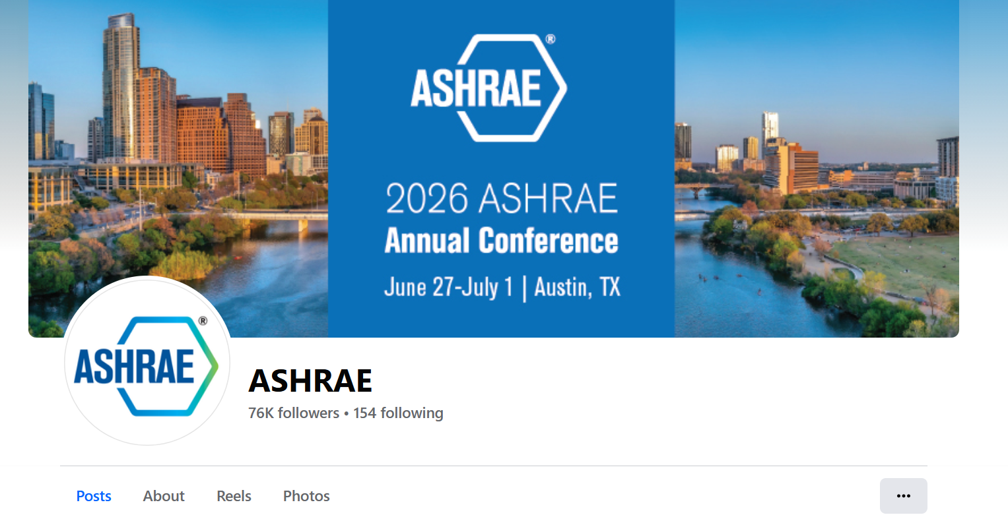
Facebook
https://www.facebook.com/ASHRAEupdates
Notes:
With 1 billion Facebook users, 340 million active Twitter users and 370 more apps, again, this is NOT just a fad!! I would strongly suggest to jump on the train sooner than later.
Who has a personal FB account? Who uses it? Why do you use it?
Who has a personal twitter account? Who uses it? Do you know how to use it?
Who is on Linkedin? Who has its company or the company they worked for on Linkedin? Who uses it?
6

Slide 16

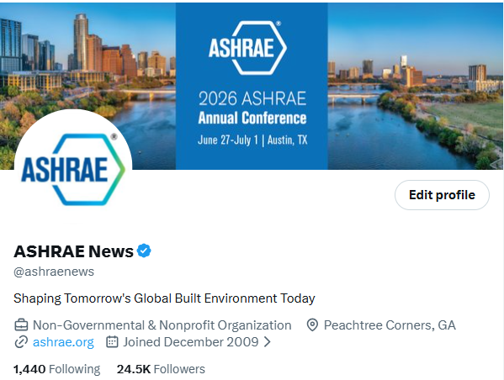
X (Earlier Twitter)
https://x.com/ashraenews
Notes:
With 1 billion Facebook users, 340 million active Twitter users and 370 more apps, again, this is NOT just a fad!! I would strongly suggest to jump on the train sooner than later.
Who has a personal FB account? Who uses it? Why do you use it?
Who has a personal twitter account? Who uses it? Do you know how to use it?
Who is on Linkedin? Who has its company or the company they worked for on Linkedin? Who uses it?
6

Slide 17
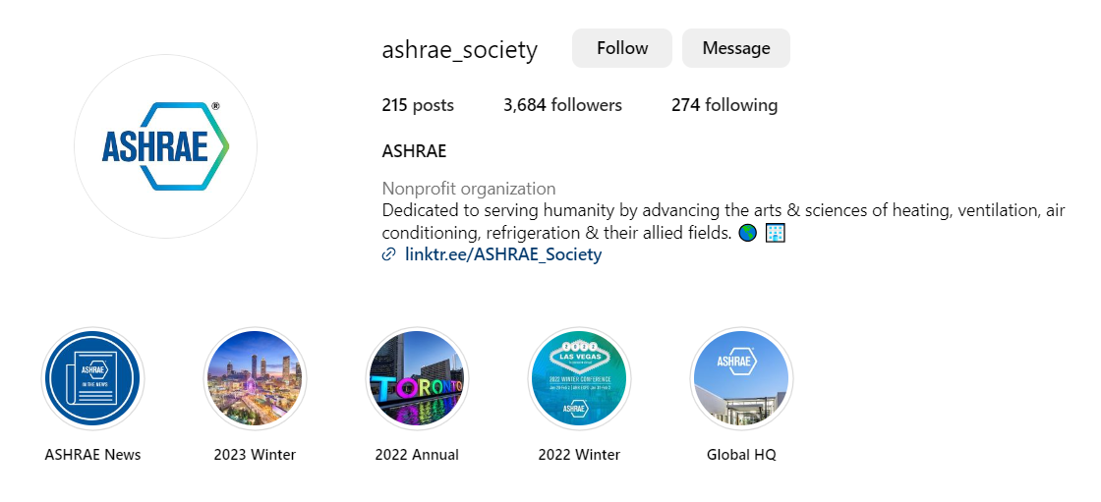
Instagram
https://www.instagram.com/ashrae_society/
Notes:
With 1 billion Facebook users, 340 million active Twitter users and 370 more apps, again, this is NOT just a fad!! I would strongly suggest to jump on the train sooner than later.
Who has a personal FB account? Who uses it? Why do you use it?
Who has a personal twitter account? Who uses it? Do you know how to use it?
Who is on Linkedin? Who has its company or the company they worked for on Linkedin? Who uses it?
6

Slide 18

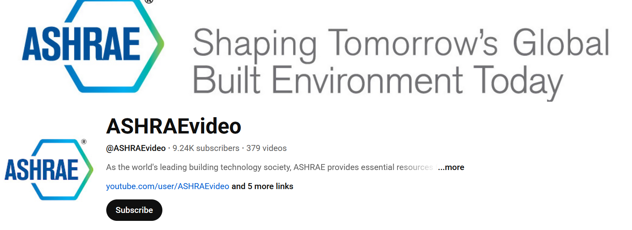
YouTube
https://www.youtube.com/@ASHRAEvideo
Notes:
With 1 billion Facebook users, 340 million active Twitter users and 370 more apps, again, this is NOT just a fad!! I would strongly suggest to jump on the train sooner than later.
Who has a personal FB account? Who uses it? Why do you use it?
Who has a personal twitter account? Who uses it? Do you know how to use it?
Who is on Linkedin? Who has its company or the company they worked for on Linkedin? Who uses it?
6

Slide 19
Building a Social Media Presence
Notes:
17

Slide 20
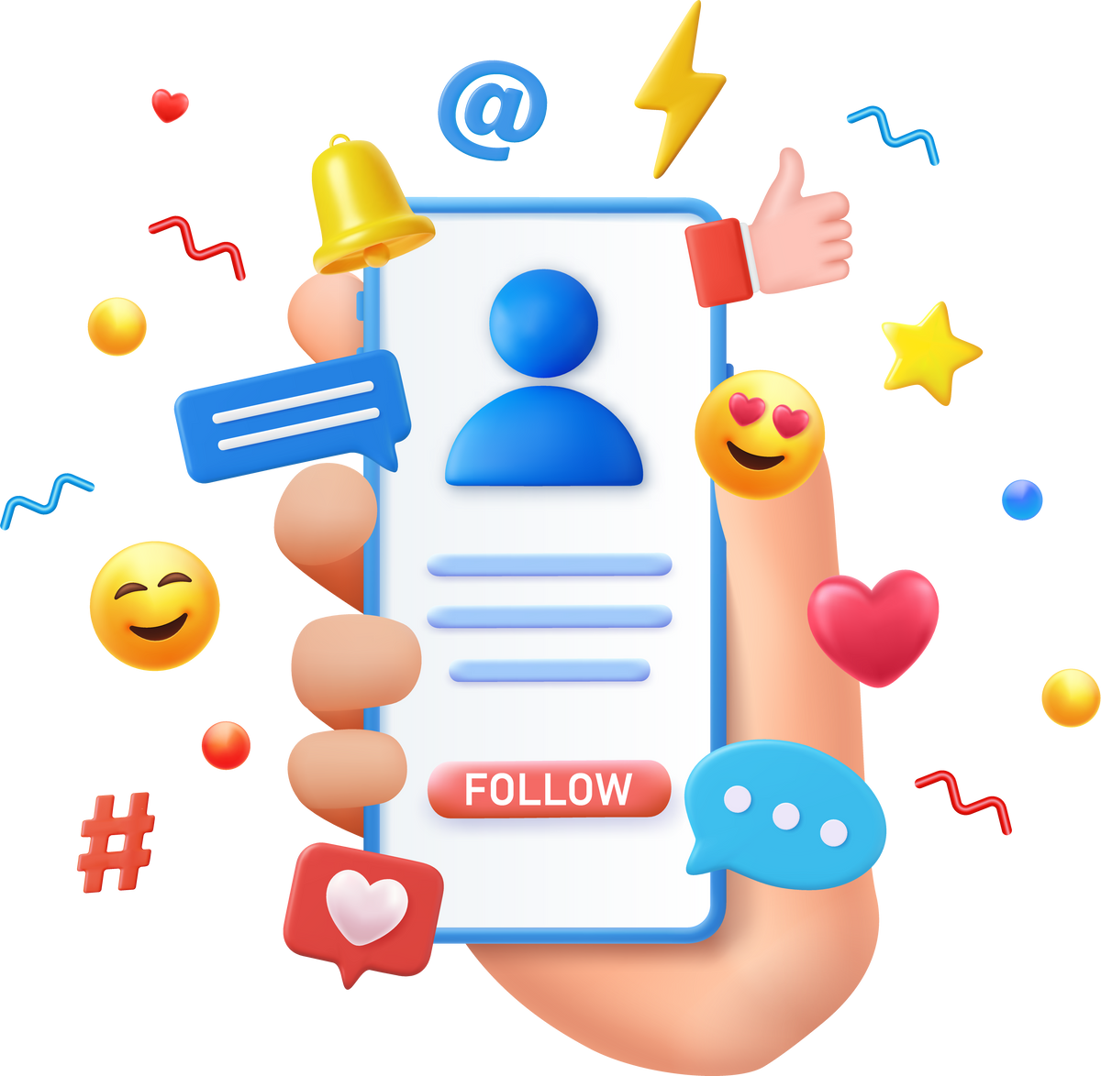
Starting on social media as a beginner
1. Choose the right platform: Select the social media platforms that align with your goals and target audience.
2. Create a profile: Set up a complete and professional profile with a clear profile picture and bio.
3. Learn the platform: Familiarize yourself with the platform's features, privacy settings, and guidelines.
4. Follow and engage: Start by following relevant accounts and engaging with their content through likes, comments, and shares.
5. Create valuable content: Share content that's interesting, informative, or entertaining to your target audience.
Notes:
18

Slide 21
Starting on social media as a beginner
6. Consistency is key: Post regularly to maintain and grow your audience.
7. Use hashtags: Incorporate relevant hashtags to expand your content's reach. ASHRAE is having #myashrae hashtag.
8. Analyze your results: Use platform analytics to track your performance and adjust your strategy as needed.
9. Be authentic: Show your personality and connect with your audience genuinely. It develops credibility.
10. Stay updated: Stay informed about social media trends and best practices to continually improve your presence.
Notes:
18

Slide 22
Facebook Accounts Type
1. Profile:
- Personal account for individual users.
- Used for connecting with friends and family.
- Limited to 5,000 friends.
- Contains personal information, photos, and posts.
3. Group:
- Community-centered, can be public or private.
- Users join and interact based on shared interests or goals.
- Members can post, comment, and discuss topics within the group.
- Group settings determine privacy and membership control.
2. Page:
- For businesses, brands, public figures, and organizations.
- No friend limit; users "like" or follow pages.
- Focus on marketing, sharing updates, and interacting with followers.
- Offers insights and promotional tools.
Notes:
18

Slide 23
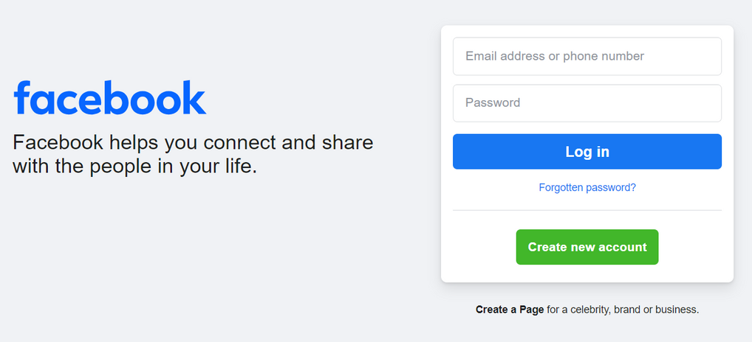
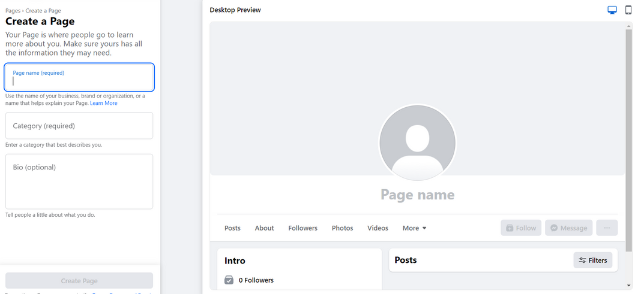
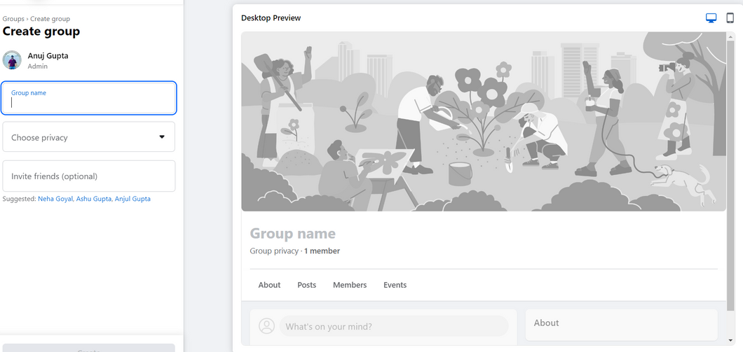
How to create FB Profile, Page and Group
Notes:
18

Slide 24

LinkedIn Accounts Type
1. Profile:
This is an individual's personal presence on LinkedIn. It highlights their professional experience, skills, and connections. It's primarily for personal networking, job searches, and career development.
3. Group:
LinkedIn Groups are communities focused on specific interests or industries. They can be public or private and serve as forums for discussions, networking, and knowledge sharing. Group members can engage in conversations related to the group's theme.
2. Page:
A LinkedIn Page represents a company, organization, or institution. It allows businesses to showcase their products, services, and company updates. Followers can stay informed about the company's developments.
Notes:
18

Slide 25
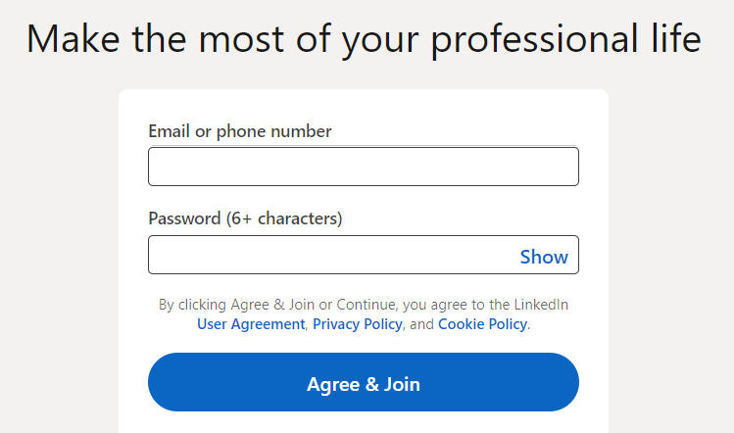
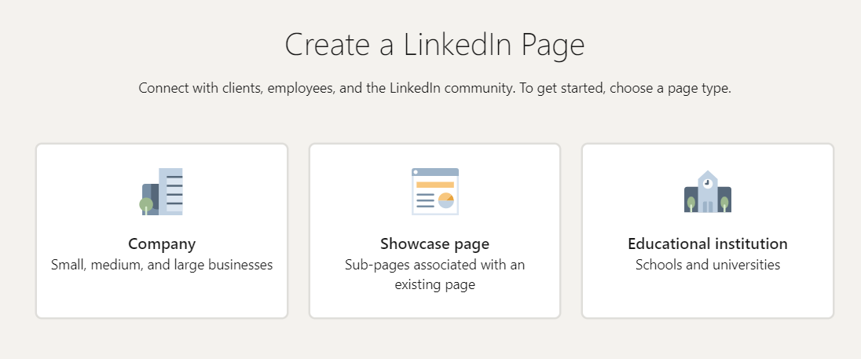
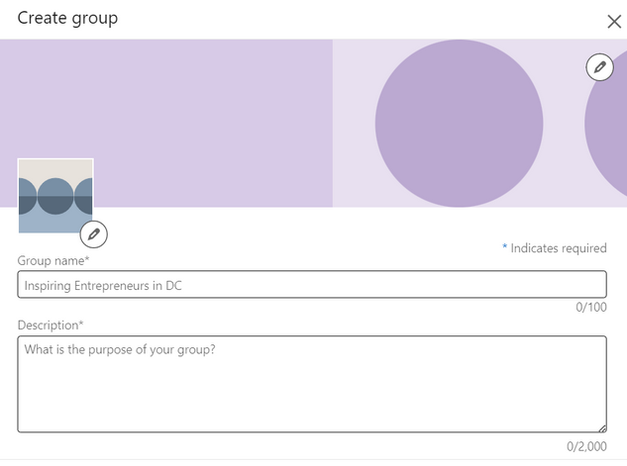
How to create LinkedIn Profile, Page and Group
Notes:
18

Slide 26
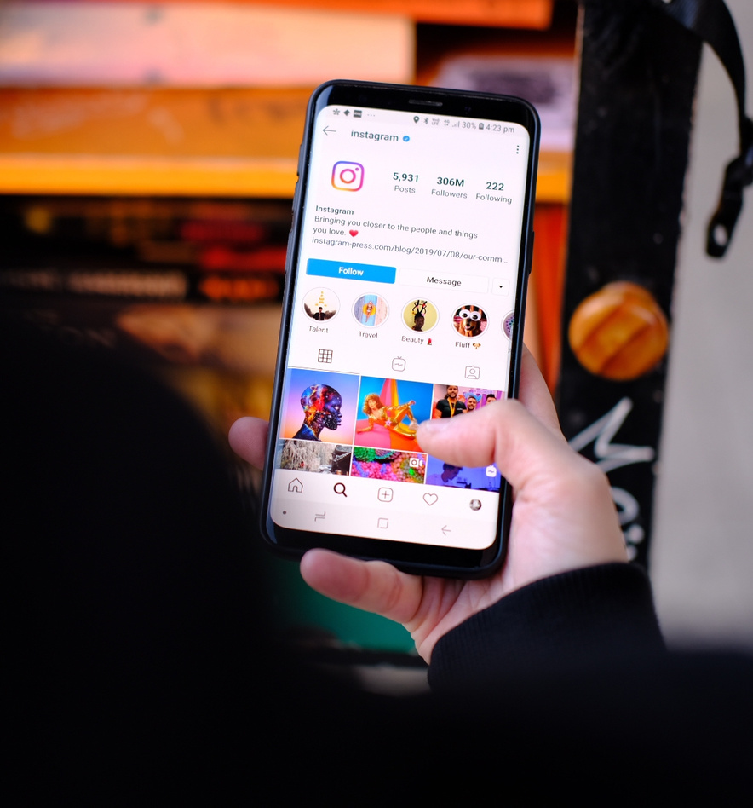
Instagram Profile
An Instagram profile is a user's personal or business page on the Instagram social media platform. It includes a profile picture, a short bio, and a collection of posts and stories that the user has shared. Users can follow each other's profiles to see their updates, photos, and videos. Instagram profiles can be public or private, and they are a way for individuals, influencers, businesses, and organizations to share content and connect with their followers.
Notes:
18

Slide 27
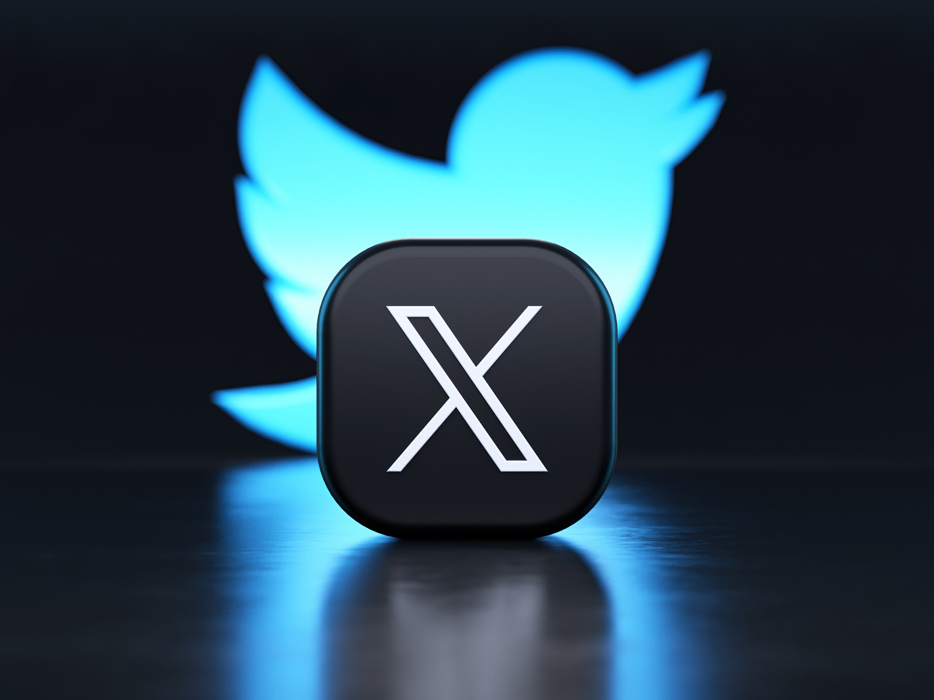
X Profile
An X (earlier Twitter) profile is an individual or organization's page on the social media platform X. It typically includes a profile picture, a cover photo, a bio, and a stream of tweets. Users can customize their profiles with information about themselves, their interests, and their activities, and they can share updates, links, images, and more through tweets. X profiles serve as the public face of users or organizations on the platform, allowing them to connect with followers and share their thoughts, news, and updates with a global audience.
Notes:
18

Slide 28
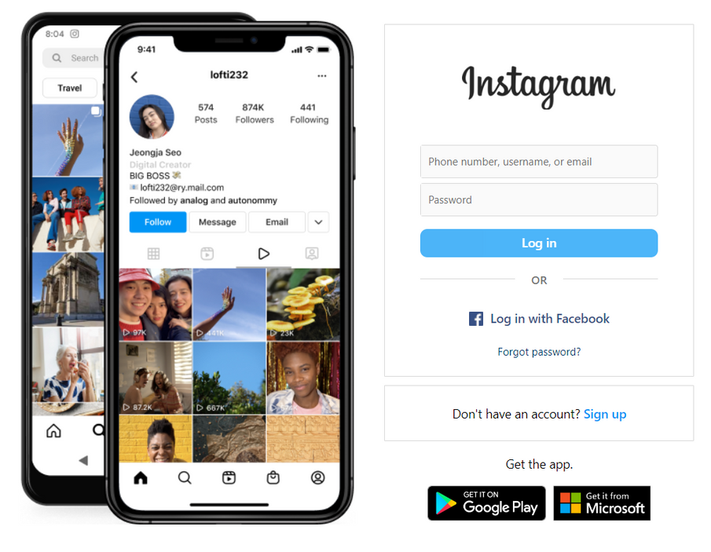
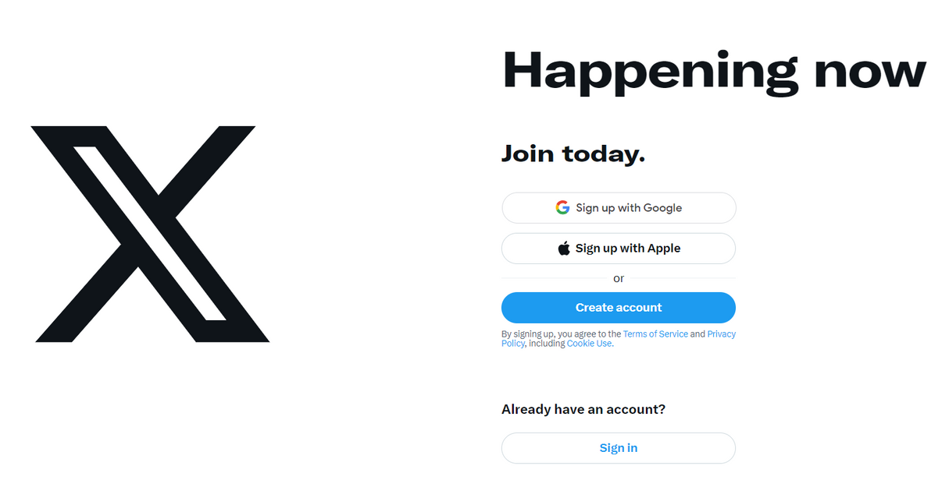
How to create Instagram & X Profile
Notes:
18

Slide 29
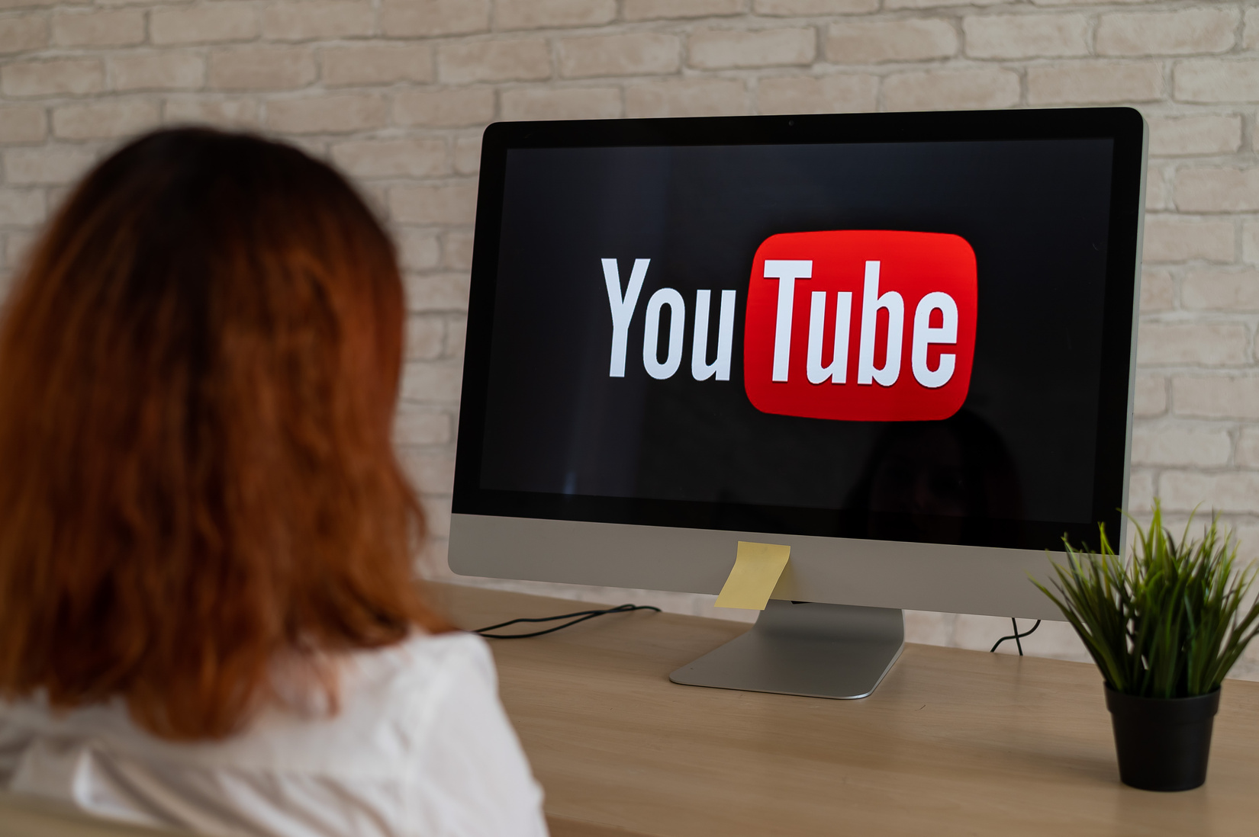
YouTube Channel
A YouTube page is a user or channel page on the YouTube platform. It serves as a dedicated space for a content creator or user to upload, organize, and share videos. It includes information about the channel, such as a profile picture, banner, video library, and description. Viewers can subscribe to a YouTube page to receive updates on new content from that channel.
Notes:
18

Slide 30
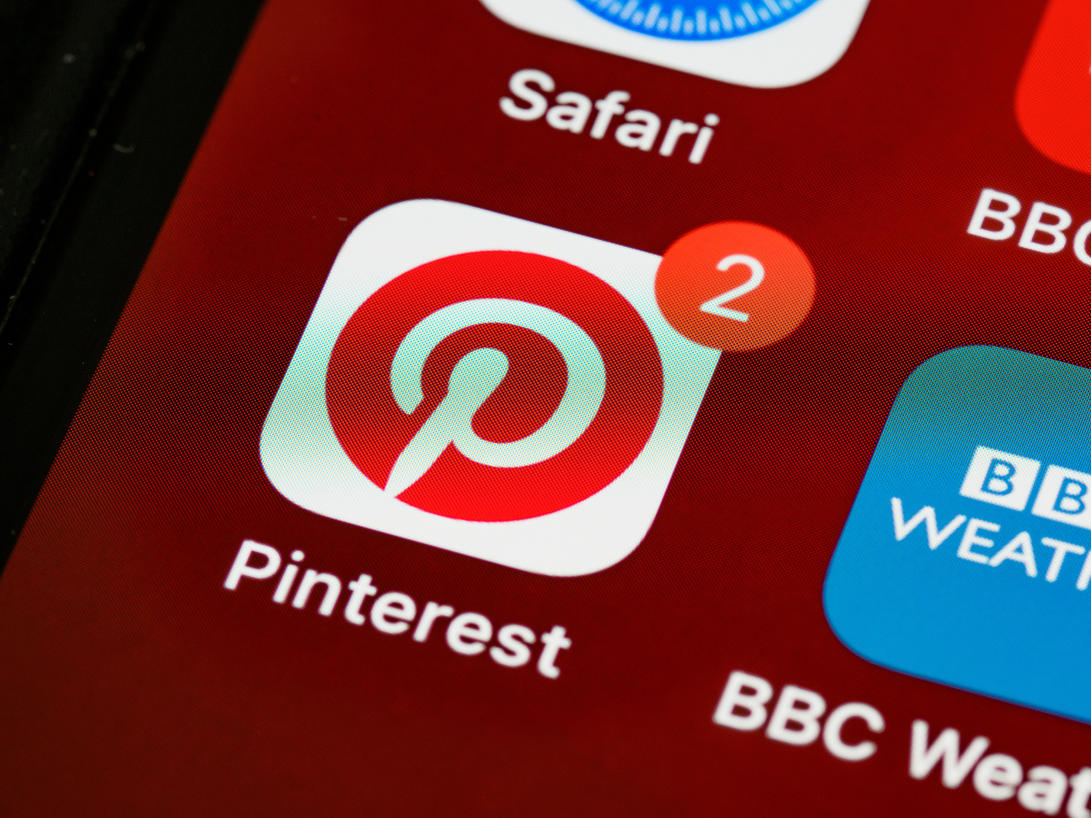
Pinterest Profile
A Pinterest profile is a personal or business account on the social media platform Pinterest. It serves as a user's presence on Pinterest and typically includes a profile picture, a short bio or description, and a collection of "boards" where users can save and organize images and content they find interesting. Pinterest profiles are used to share and discover content related to various interests and hobbies
Notes:
18

Slide 31
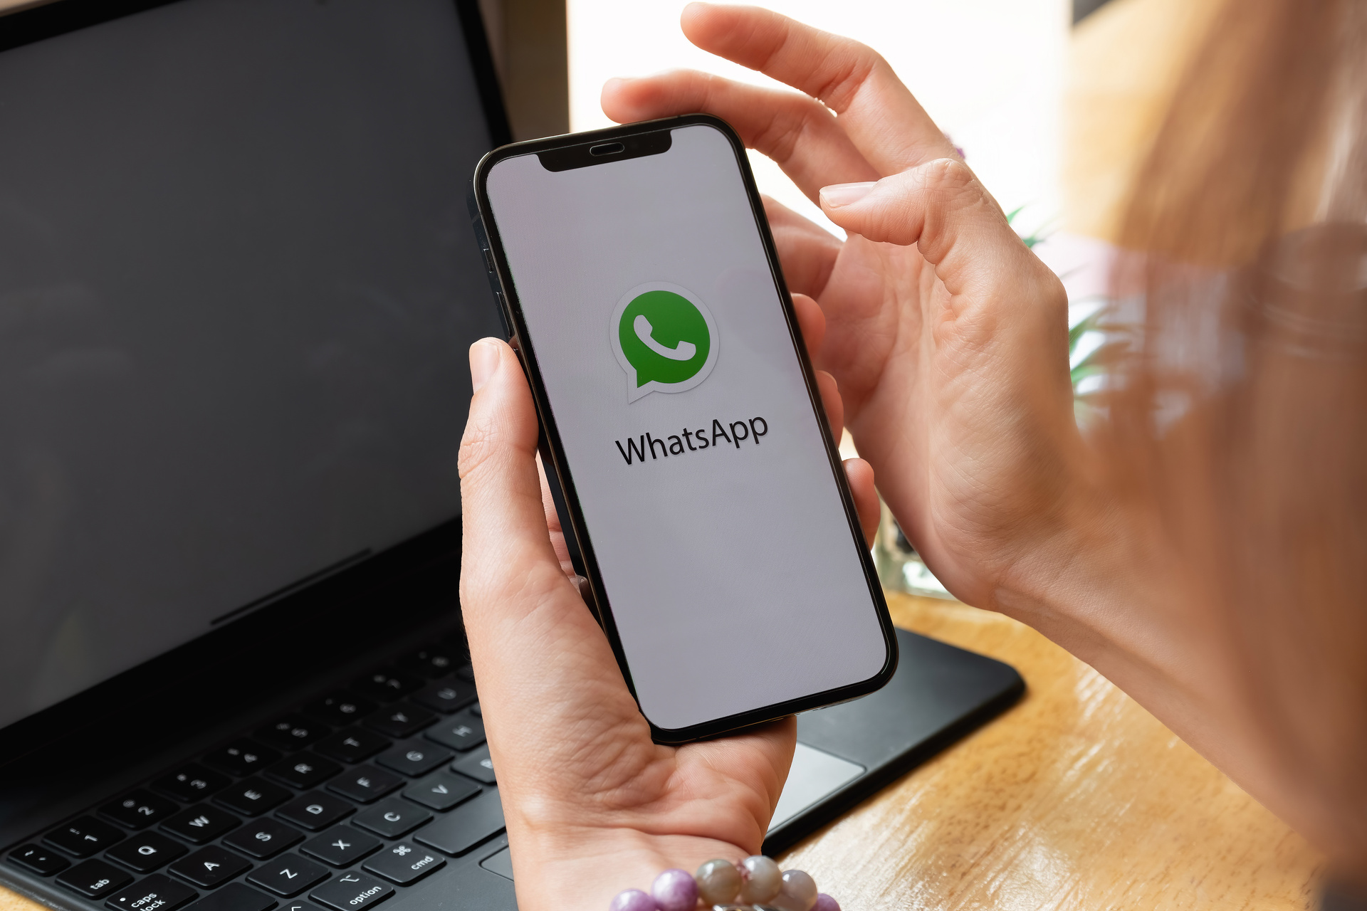
Whatsapp Group
WhatsApp groups are chat spaces on the WhatsApp messaging app where users can communicate with multiple people simultaneously. They're used for various purposes, such as work, socializing, or event planning.
It can be utilized for ASHRAE activities by creating a dedicated space for members to discuss events, share updates, and collaborate on projects. Admins can coordinate communication, share relevant documents, and facilitate quick information exchange among ASHRAE Members in a convenient
and real-time manner.
Notes:
18

Slide 32
Best Practices for Facebook
Notes:
22

Slide 33

Think like your audience
  What type of content resonates most with you on Facebook?
  What visual elements grab your attention while scrolling through your Facebook feed?
  How does Facebook foster a sense of community for you?
  What encourages you to comment or share?
  Why do you participate in interactive experiences, such as polls or Q&A sessions?
Notes:
23

Slide 34
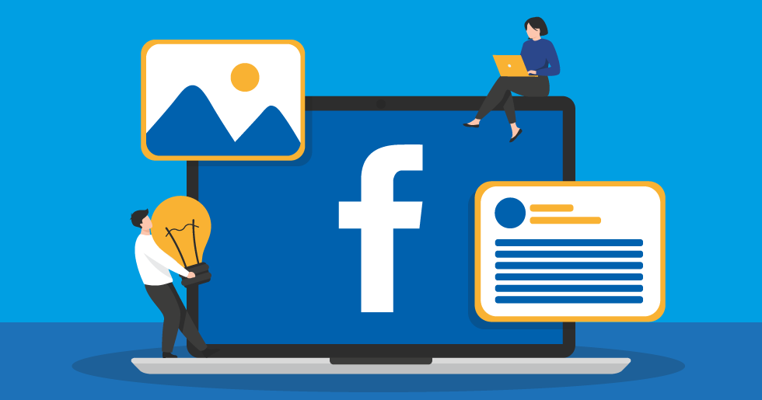
Have this Discussion With Your Social Media Team
Incorporate What you Like Into your Page!
Notes:
24

Slide 35
Quick-Start Guide
  Optimize your profile
    Include a relevant “About” page with detailed information
  Develop a posting strategy
    Know your audience and plan engaging content
    Identify peak times and frequency for posting to maximize visibility
    Include high-quality visuals (photos and videos) often
  Engage with followers and network with other organizations
  “Like” other pages (ASHRAE Society or ASHRAE Chapters) and share posts
  Use Facebook Analytics to measure the success of your page
Notes:
25

Slide 36
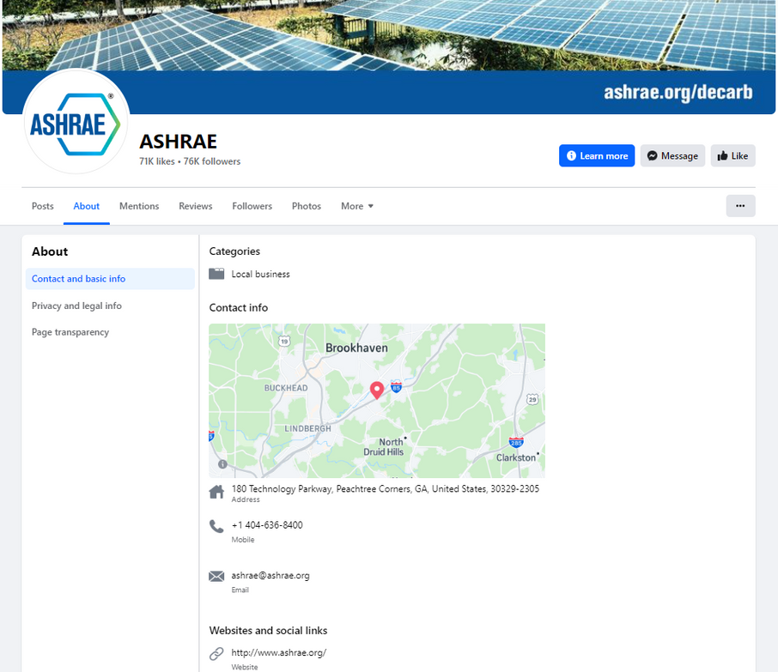
Fill in appropriate fields and information
  Name
  @Username
  Profile and Cover Photos
  Category (non-profit organization)
  Contact Information (address, phone number)
  Business Hours
  Chapter highlights, history, and story
  Milestones and Achievements
  Call to Action (link to website)
  Testimonials
Notes:
26

Slide 37

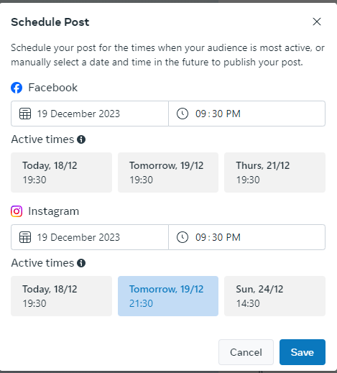
Log In and Post Often
  A reliable strategy is essential as you plan your Facebook for business page: think, plan and manage your page based on your target audience, brand story and the desired reaction you want to obtain.
  Consider every piece of content you post an opportunity for increased and specific engagement.
  Develop a balanced posting schedule and use the scheduling tool.
  Respond to and engage with followers.
Notes:
Frequent Posts Keep you in Front of your Members
Keep Current On Your Member’s Interests
Use Scheduling Tool to Help
Use Insights Feature to Tailor your Posts (If people really engage in surveys, but don’t engage as much in “fill in the blanks” do more surveys)
27

Slide 38
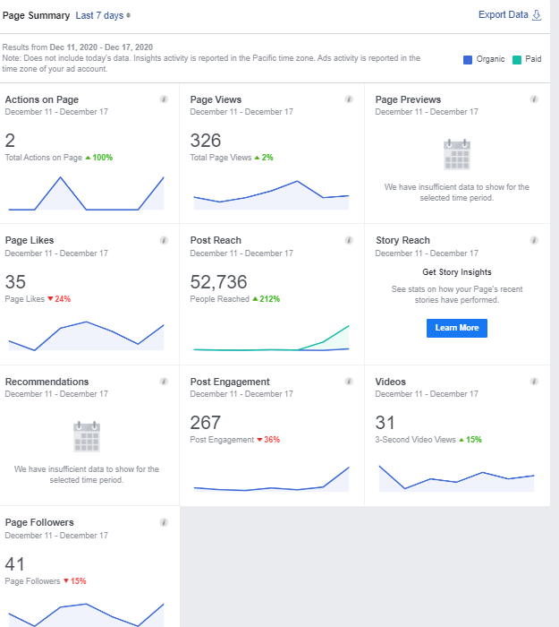
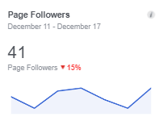
Use Facebook’s Insights Tool
  Facebook Insights: detailed analytics for your Facebook Page, so you can track what works, learn how people interact with your content, and improve your results over time.
  What to track using Facebook Insights:
    Reach and Engagement: number of people who saw your posts and combined total of post likes, comments, shares, etc.
    Actions: combined total clicks
    People: number of followers, demographics of people who visit your page and when they visit
    Views: total views of your Facebook page
    Posts: how posts are performing over time
Notes:
Hootsuite and SproutSocial are Just a Few Management Tools for Social Media
28

Slide 39

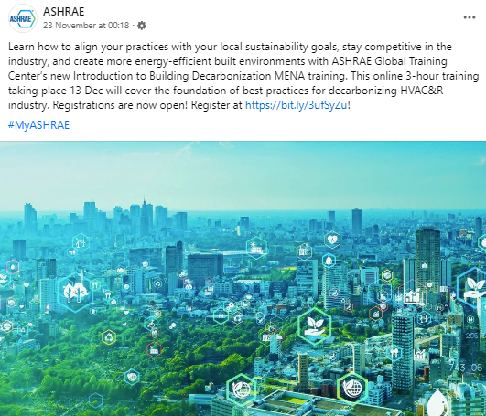
Keep Content Interesting
  Facebook is a visual media
    Eye-catching images
    Include movement with a video or gif
  Achievements/Awards
  Announcements
  Behind-the-Scenes
  Communicate value
    Contests and giveaways
    Discounts, promotions and sales
    Educational content
Notes:
Good Pictures
Meetings (Presenters, People Attending, Etc)
Chapter Events (Golf, Parties, Awards Banquets, Etc)
Member Spotlights (Get to Know your Board)
Local Projects
Conferences
Surveys
Questions
Videos
Statistics
Events
Thank Your Members/Sponsors
29

Slide 40
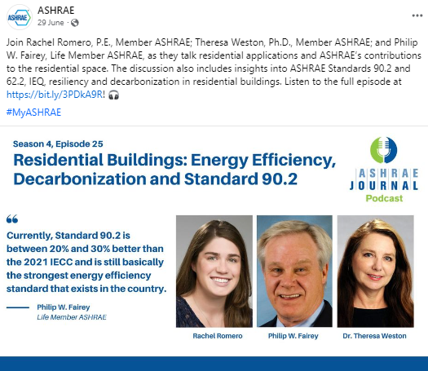
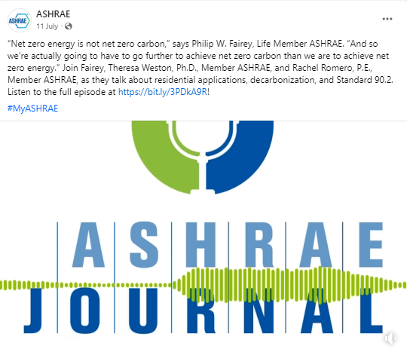
Keep Content Interesting
  Events
  Facts/Statistics
  Fill-in-the-Blanks
  Industry-Related Holidays/Observations
  Industry News and Tips
  Inspirational Quotes
  Member/Volunteer Spotlights
  Polls
  Questions
  Research/Technical Articles
  Stories
  Surveys
  Testimonials
Notes:
30

Slide 41


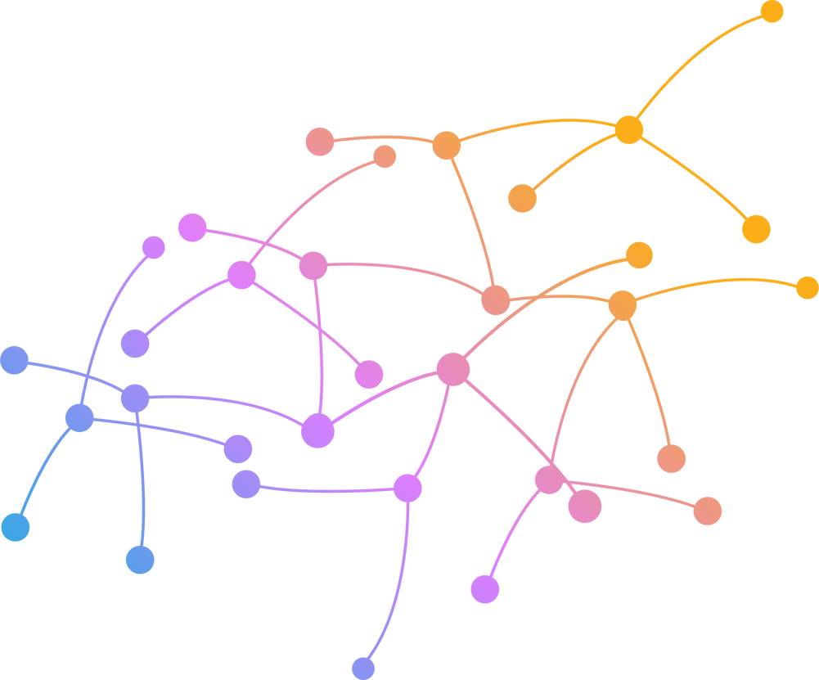




Network with Other Chapters & Organizations
  Examples:
    Other ASHRAE Chapters
    ASHRAE Society Groups
    ASPE Chapters
    City Councils
    Local News
    NAWIC Chapters
    USGBC Chapters
  Share Relevant Information
  Contribute to Mutual Growth
Notes:
31

Slide 42
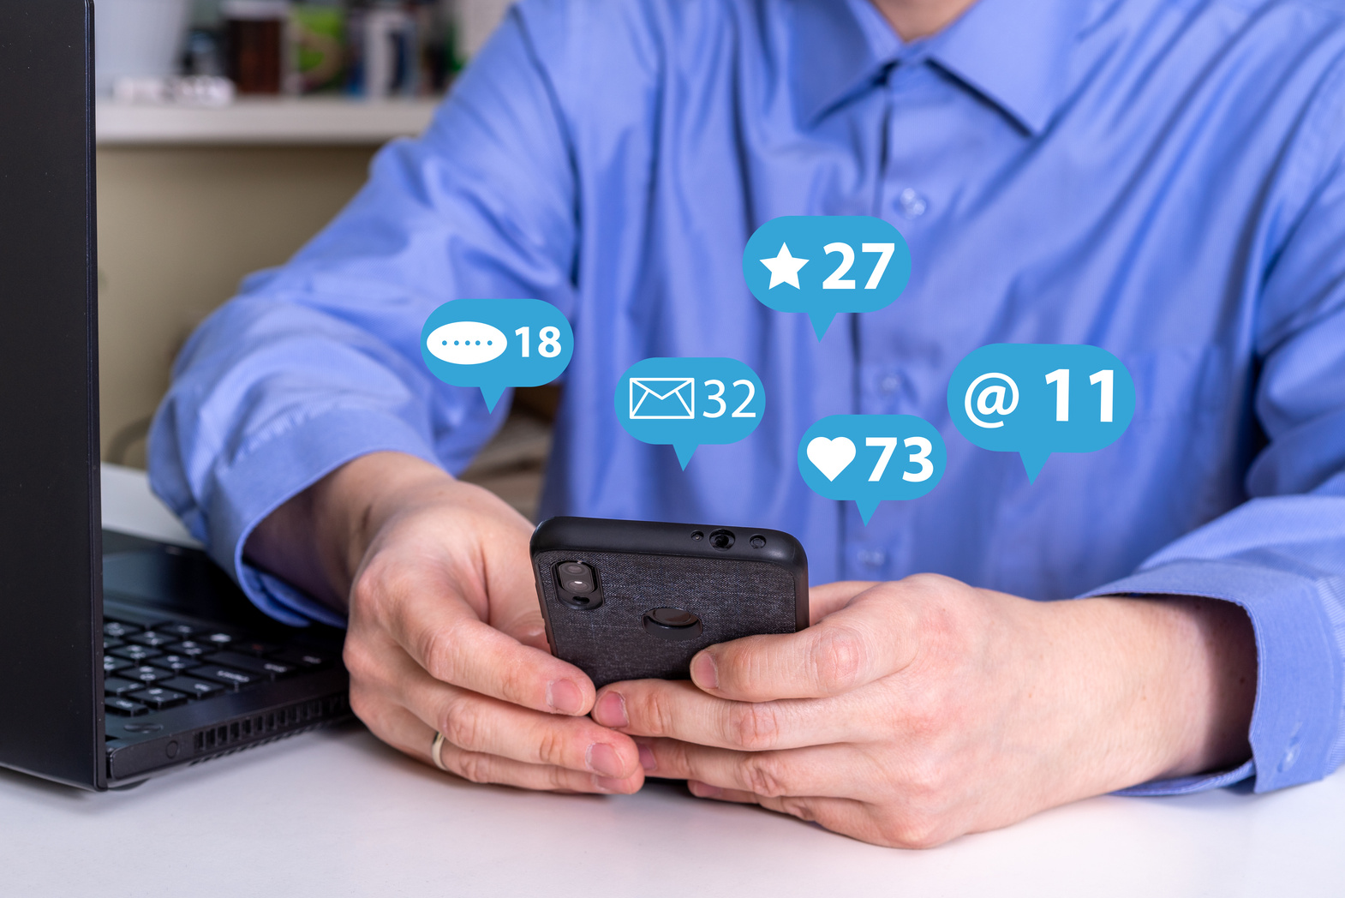
Stay Engaged
  Answer Private Messages with tailored responses.
  Acknowledge comments on your posts by responding thoughtfully and expressing appreciation through likes.
  Aim to respond to comments and messages within 24 hours, demonstrating a commitment to timely communication.
  Actively initiate conversations with your audience through comments, encouraging participation.
Notes:
32

Slide 43
More Advice!
  Include a Call to Action and link in your posts
  Be personable, not just promotional
  Include relevant #Hashtags
  Include chapter history stories and pictures
  Share relevant content from other sources
  Pin your best-performing post or one you wish to highlight at the top of the page
  Create and promote Events, invite people, and share specific information
  Link other social media sites for your organization to your Facebook page
  Leverage Facebook ads and boosted posts
  Continue to learn and stay current about social media topics and networks
Notes:
33

Slide 44

Consider…
Have this Discussion With Your Social Media Team
Avoid Being the “Unliked” Page
Notes:
35

Slide 45

Avoid these common mistakes!
  Don’t Do It Alone
    Rely on your team and your board – assign many admins
  Don’t Leave your “About” Section Blank
  Don’t Forget to Post
    Stay up to date and be consistent
    Use scheduling tool
  Don’t Post Just to Post
    Your posts should be of value
  Don’t Post Low-Quality Images
  Don’t Use Poor Grammar
  Don’t be Overly Promotional
  Don’t Advertise Products
    ASHRAE has a Non-Commercialism Policy
Notes:
36

Slide 46
Avoid these common mistakes!
  Don’t Ignore Posts or Messages by your Members
  Don’t Post “Questionable” Images, Statuses, etc.
    Ensure Your Page Stays Family, Business and ASHRAE Friendly
  Don’t Post Irrelevant Content for the Sake of Engagement
  Don’t Forget to Test Links
  Don’t Hesitate to Ask for Help
Back to List of Topics
Notes:
37

Slide 47
LinkedIn Case Study
Notes:
38

Slide 48
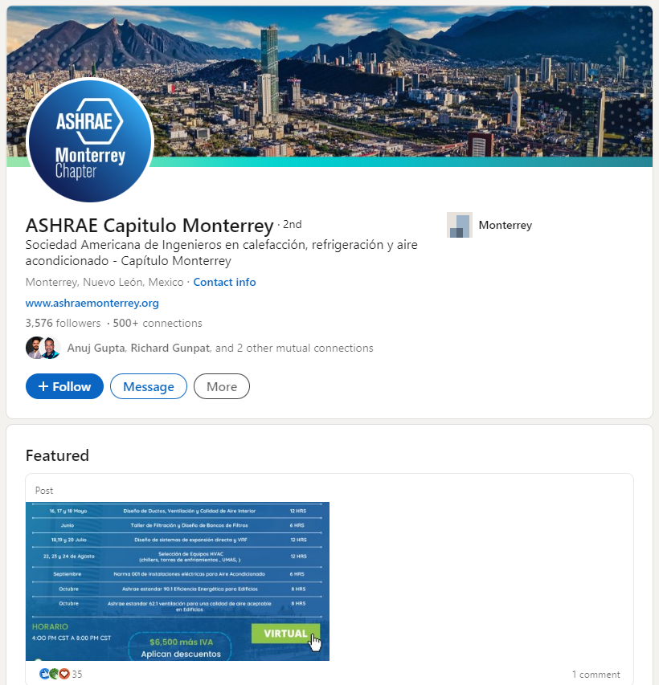
Case Study - 1
ASHRAE Capitulo Monterrey
3576 followers
This is Chapter LinkedIn Profile
Notes:
39

Slide 49
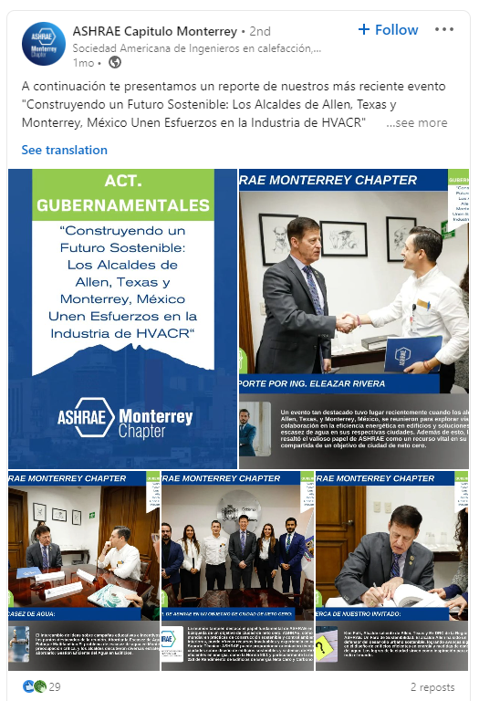
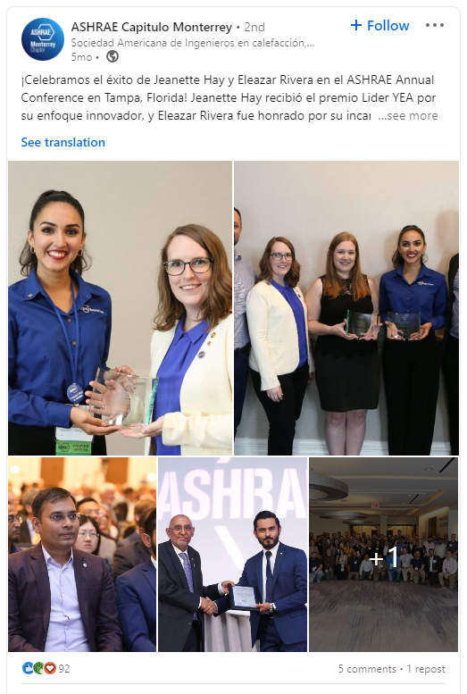
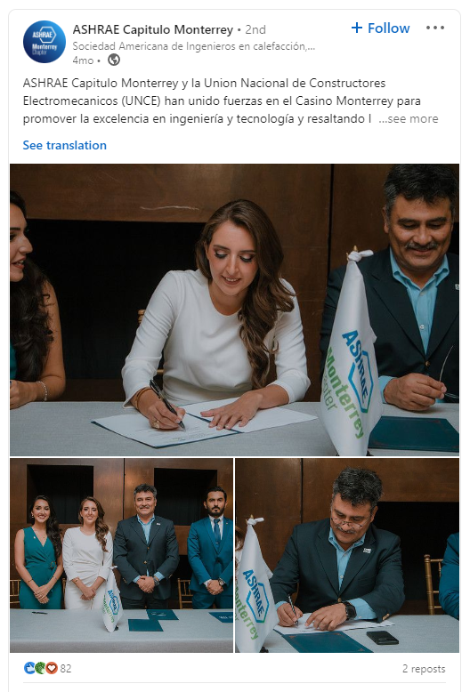
Example posts from Chapter Events
Notes:
41

Slide 50
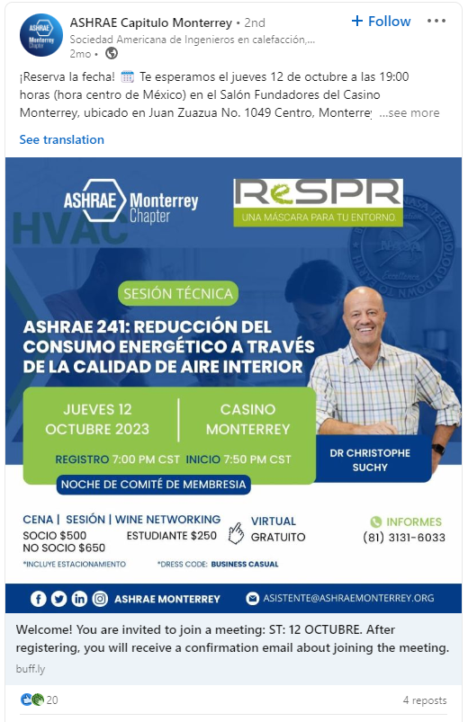
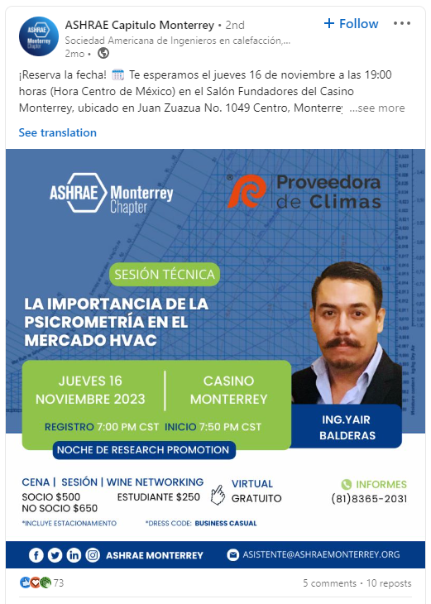
Example posts promoting events
Notes:
42

Slide 51
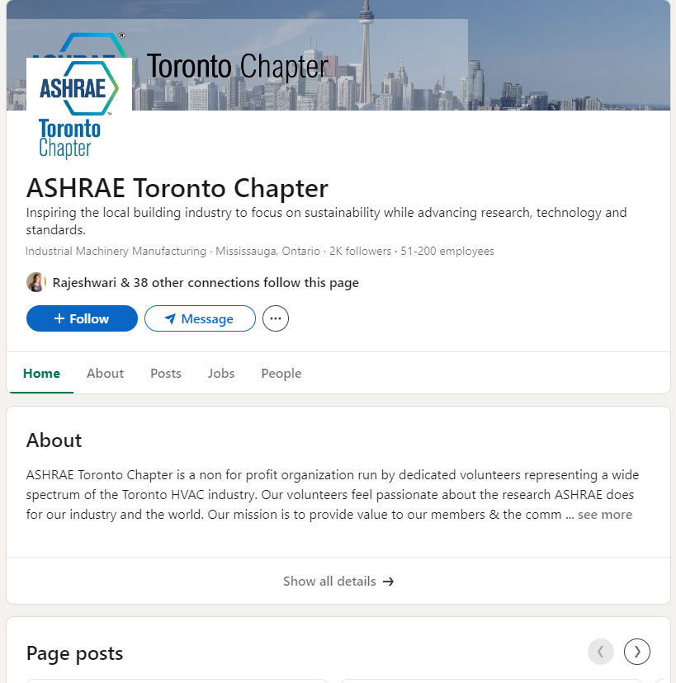
Case Study - 2
ASHRAE Toronto Chapter
2400+ followers
This is Chapter LinkedIn Page

Slide 52
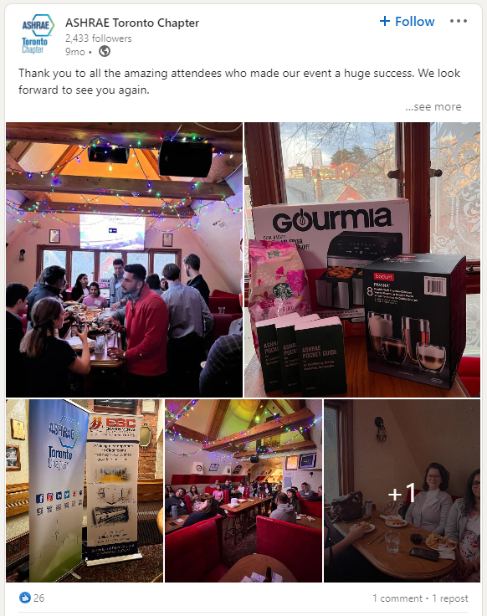
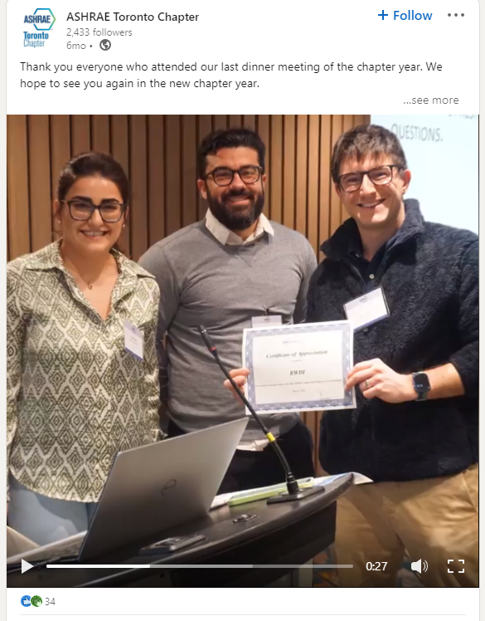
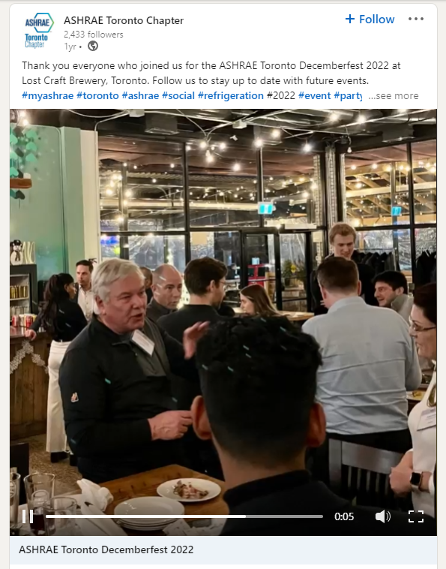
Example posts from Chapter Events

Slide 53
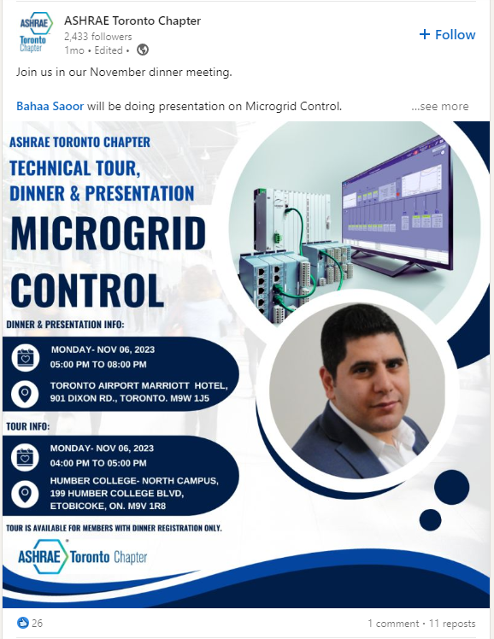
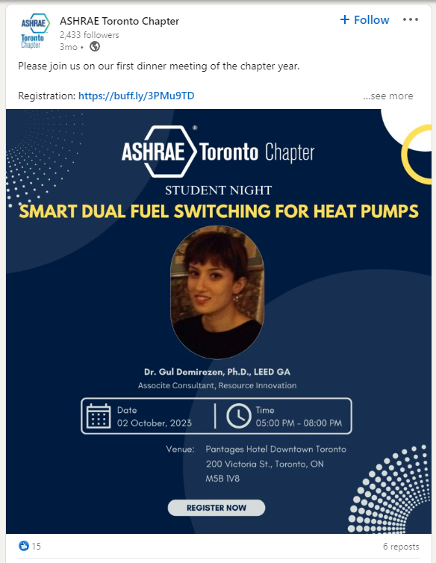
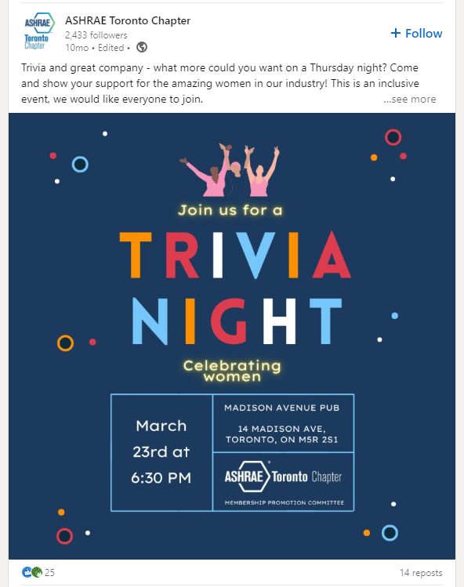
Example posts promoting events

Slide 54

Case study lessons learned
  Engage with other ASHRAE chapters or other local chapters.
  Use the scheduling tool to schedule posts for a week or two at a time. This reduces the total workload required.
  Regular posts help increase likes and reach over time.
  Users prefer images to links or text.
Notes:
44

Slide 55
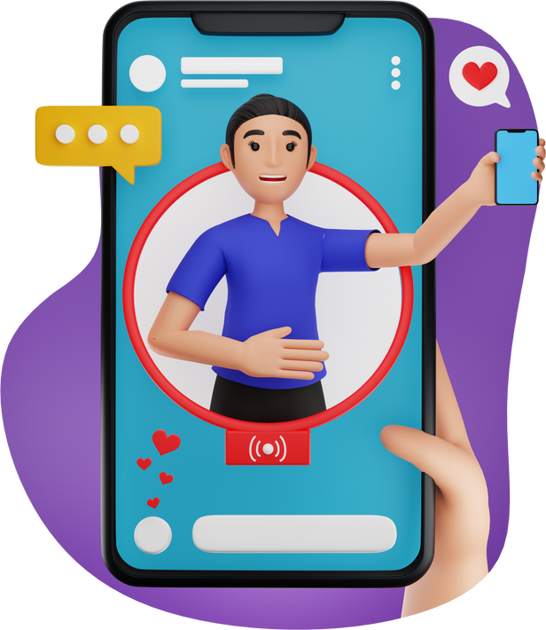
Live - posting
  Live-posting at events works particularly well
    But only if your social media person is at the event!
    If multiple people help run the page, they can all individually post at events.
  Tagging the main ASHRAE page and having our post shared gained us ~50 new likes over the course of 24 hours.
    We gained ~30 new likes over the course of 6 months with our regular posting.
  Keep the ASHRAE Commercialism Policy in mind.
Notes:
45

Slide 56
Sourcing unique content for your page
  Images, videos, and posts live at Chapter Events (including BOG meetings)
  Follow other people or pages of interest from your group’s Facebook Page and share posts:
    ASHRAE and other ASHRAE Chapters or Groups
    ASME, AIA, BOMA, ACCA, SWE, NSBE, SHPE, USGBC, and local chapters of these group
    Local government entities
    Local universities (especially if there is a large alumni base in your chapter from a university)
Notes:
46

Slide 57
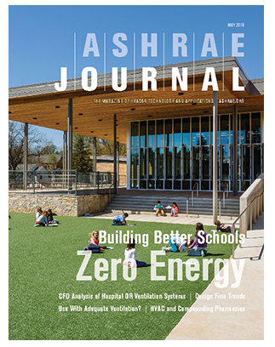
Sourcing unique content for your page
  Weekly e-mails from ASHRAE (ASHRAE News)
  ASHRAE Journal
  Articles from your chapter newsletter
  Your chapter’s history archives (#ThrowbackThursday / #tbt)
  YouTube (ASHRAE Page)
  Testimonials
  Ask Questions / Create a Poll
    Would you prefer lunch or dinner meetings?
    Which ASHRAE Certification do you have?
Notes:
47

Slide 58
Conclusions
  3.6 Billion Social Network Users Worldwide
  Social Media is the new word of mouth, so be heard!
  Post frequently and engage with members.
  Need help or have questions? Contact ASHRAE’s Communications Committee at ccchair@ashrae.net
Back to List of Topics
Notes:
48

Slide 59
Appendix
Notes:
49

Slide 60


Twitter Do’s
  Link your Facebook and Twitter Accounts
    www.facebook.com/twitter
  Use hashtags to maximize engagement
    Research hashtags relevant to your location, industry and products and add up to two of them per tweet, where appropriate.
    #MyASHRAE, #AHRExpo
  Use mentions to call attention to or draw the attention of other Twitter accounts by using @
    @ashraenews, @ahrexpo
  Include a clear call-to-action where applicable.
    “Read the full story…”

Slide 61



Twitter Do’s
  Be Visual/Include Images with Tweets
  Be Consistent with Tone and Voice
  Follow Specific, Relevant Accounts
  Re-Tweet Applicable Posts
    Credit the account when re-Tweeting
  Develop Relationships and Connections
  Include Website Links and be Strategic
    Use a URL shortener
  Pin Posts to your Profile
  Analyze your Account

Slide 62
Twitter Don’ts
  #Don’t #Abuse #Hashtags!
    Hashtags are used to help search for specific keywords
    Don’t use it on every word
    Hashtags should be easy to remember
    The goal is to create a hashtag that people use!
  Don’t use other people’s content or hashtags and claim them to be yours
  Don’t be insensitive
  Don’t over-promote
  Don’t use abbreviations that are too confusing

Slide 63

Twitter Don’ts
  Don’t be “Needy”
    Don’t Use “Retweet this Tweet Please”
    Don’t Beg Friends to “Like” your Page
    Produce Unique Ways to Encourage These Actions
  Don’t Link Every Post to Facebook and Vice Versa
    Incorporate variety and cater the post to the platform
Back to List of Topics

Slide 64

What is LinkedIn?
  The World’s Largest Professional Network
    > 1 Billion Users
    202 Million in the US
    69% of Users Engage with LinkedIn Daily
  Main Audience – Professionals
  People Use LinkedIn to:
    Post a resume and search for jobs
    Connect with former and current colleagues
    Participate in groups and network
    Write articles, post photos and videos
Notes:
You can export LinkedIn contacts to a spreadsheet with emails, so you can do an outreach email
LinkedIn has not only professionals:
Companies
Groups
Jobs opportunity
Articles
Universities
Messaging

Slide 65
LinkedIn Do’s
  Treat your Profile like a Professional Brochure
    Update as needed with current officers and board members
    Provide a detailed description, using simple language
  Provide Link Between Website, other Social Media accounts/pages and LinkedIn Pages
  Enhance your profile by incorporating rich media, such as videos, presentations, or infographics.
  Regularly update with your latest accomplishments and professional milestones.

Slide 66


LinkedIn Do’s
  Craft a detailed yet easily understandable description of your professional background.
  Establish Connections and Cultivate your Online Network
    Follow associates in your area (i.e. members, other chapters, other “peer” organizations, potential members, relevant companies/organizations)
    Use “Connections” to increase Chapter membership
  Choose Groups Wisely
  Encourage colleagues and peers to provide recommendations to enhance your professional credibility.

Slide 67

LinkedIn Do’s
  Stay Active with Posts and Updates
    Respond promptly to messages
    Post relevant articles and events to engage members
  Encourage your employees to follow the company page and share company updates
  Engage with relevant industry content by commenting, sharing, and contributing to discussions.
  Regularly share industry news and updates to demonstrate your commitment to staying informed.

Slide 68
LinkedIn Don’ts
  Don’t use LinkedIn as a “Social” Site
    It is considered a “professional” site and is different from your Facebook page
    Provide professional articles, discussions, and research
  Don’t Allow your Profile to be Stagnant
  Don’t have a casual or inappropriate Profile Photo
  Don’t Post Faulty Links
  Don’t Only Post about your Chapter

Slide 69
LinkedIn Don’ts
  Don’t Connect without Researching First
  Don’t send connection requests without a personalized message
  Don’t Send Spammy/Irrelevant Messages
  Don’t forget LinkedIn etiquette
  Don’t Allow “Poaching” on Your LinkedIn Site
    You can post job opportunities (based on Your Chapter’s rules)
    “Poaching” or “Headhunting” should be discouraged as it can create a negative association with your LinkedIn page and/or your Chapter
Back to List of Topics

Slide 70

What is Instagram?
  2.5 Billion Monthly Active Users
  990Million Daily Active Users
  Primary Audience - Young Adult
    71% of 18 – 29 U.S. adults use Instagram
  Instagram Uses:
    Photo and Video Sharing/Viewing
      Editing capabilities with filter options
      Captions with @ tagging and hashtags
      Instagram Stories
    Company/Organization Brand Building
    Promotional Contests
    Follow Accounts of Interest and Share Content

Slide 71
Instagram Do’s
  Connect Instagram with your Facebook Page
  Capitalize on your Bio
  Develop a Posting Rhythm that Suits you
  Stay on Brand
  Update Link in Bio to be Consistent with Recent Post(s)
  Include a Variety of Photos/Videos, Reels, Carousels
  Use Instagram Stories

Slide 72

Instagram Do’s
  Engage and Interact with your Audience
  Ask questions
  Like and Comment on others’ content
  Measure Performance
  Put out content regularly
  For visually impaired users, provide image descriptions to enhance accessibility
  Share Responsible Content
  Participate in trends thoughtfully

Slide 73
Instagram Don’ts
  Don’t Post for the Sake of Posting
    Like all social channels, never post content on Instagram without a purpose.
  Don’t Abuse Hashtags
    Only use hashtags that are applicable to your post
  Don’t Post Low-Quality Images/Video
  Don’t Neglect your Captions
  Don’t attempt to increase your follower count through follow-unfollow tactics
  Don’t post too many Stories in a short period
  Don’t Ignore comments or interactions on your posts
Back to List of Topics

Slide 74
What is Pinterest?
  Pinterest is a visual discovery engine where people can search for inspiration and ideas for their interests and hobbies.
  Primary Audience - Women, Foodies, Crafters
  Share Visual Content:
    DIY Projects
    Home and Style Inspiration
    Recipes
    Tutorials
  98% of Users say they’ve tried something new they found on Pinterest

Slide 75
Pinterest Do’s
  Optimize Profile: Use a clear picture, keyword-rich description, and website link.
  Create High-Quality Pins: Design visually appealing pins with keywords.
  Pin Regularly: Keep content fresh and schedule pins strategically.
  Use Keywords: Research and incorporate relevant keywords.
  Organize Boards: Create well-organized, descriptive boards.
  Engage: Like, comment, and repin others' content.
  Enable Rich Pins: If applicable, enable rich pins for added info.
  Analyze with Pinterest Tools: Use Pinterest analytics for insights.
  Collaborate: Join group boards in your niche.
  Consider Paid Promotion: Explore Pinterest's advertising options for broader reach.

Slide 76
Pinterest Dont’s
  Don't neglect pin descriptions
  Don't overlook image quality
  Don't pin without context
  Don't neglect board organization
  Don't pin irrelevant content
  Don't skip pin source verification
  Don't pin inaccessible links
  Don't disregard copyright

Slide 77

YouTube Do’s
  Create high-quality videos.
  Be consistent with your uploads.
  Optimize Videos titles and descriptions.
  Engage with your channel audience.
  Use custom thumbnails. You can use Canva for it.
  Promote your videos through other platforms like FB & Linkedin
  Collaborate with other chapters.
  Create playlists to segregate your video content.
  Utilize SEO.
  Stay informed about YouTube trends and policies.

Slide 78
YouTube Dont’s
  Copyright Violation: Avoid using copyrighted content without permission.
  Clickbait: Refrain from misleading or exaggerated titles and thumbnails.
  Guideline Violation: Follow YouTube's community guidelines.
  Sub4Sub: Do not artificially inflate your subscriber count.
  Comment Spam: Avoid spamming comments.
  Deceptive Metadata: Use accurate video information.
  Lack of Engagement: Encourage interaction with your content.
  Inconsistent Posting: Maintain a regular schedule.
  Early Monetization: Focus on building an audience first.
  Analytics Neglect: Regularly analyze video performance.

