Slide 1



Healthy Buildings: Designing for Life
Bill McQuade, P.E., CDP, Fellow ASHRAE, LEED AP
2025-26 ASHRAE President
Little Roundtop, Gettysburg, PA
Little Roundtop, Gettysburg, PA

Slide 2





Shelter is
Necessary for survival, safety and wellbeing.
Essential for emotional and psychological security.
Notes:
Last summer, when I introduced my presidential theme, Healthy Buildings: Designing for Life, I challenged our Society to think bigger about the role of the built environment.
Buildings are more than shelter. They shape how we live, work, learn, and heal. When designed well, they can actively support human well‑being.
By balancing energy efficiency with high‑quality indoor environmental quality, we create buildings that don’t just perform better, they serve people who occupy them better. Buildings that support health, boost productivity, and create lasting value for both people and the planet.

Slide 3


Do a good turn daily.
Notes:
Now it’s our time to do another “good turn” – to prioritize the human experience and ensure that every space we create protects and supports the people inside it.

Slide 4

The Trail Forward:
Be Prepared
Notes:
Like any meaningful journey, preparation matters. We need a clear plan and the right tools. Last June, I laid out the initiatives that would guide our work over the next 12 months as we began this important IEQ journey.

Slide 5
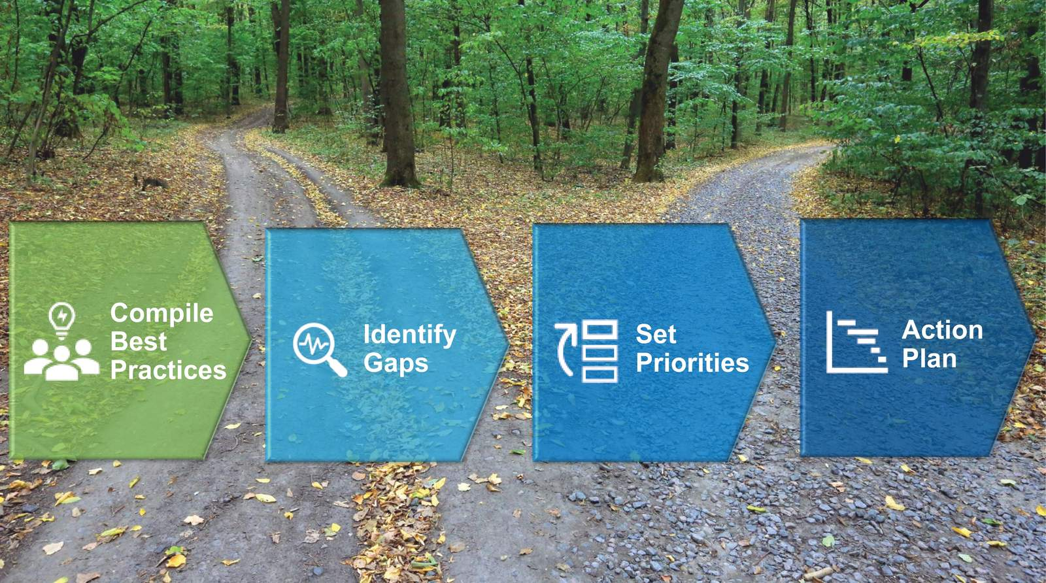
Presidential Initiatives
Roadmap for Healthy Buildings
Notes:
First, we need a clear plan. Last June, I committed ASHRAE to developing a multi‑year roadmap for healthy buildings –one that sets clear goals, identifies best practices, addresses gaps, and turns indoor environmental quality into practical, actionable results for the industry.

Slide 6
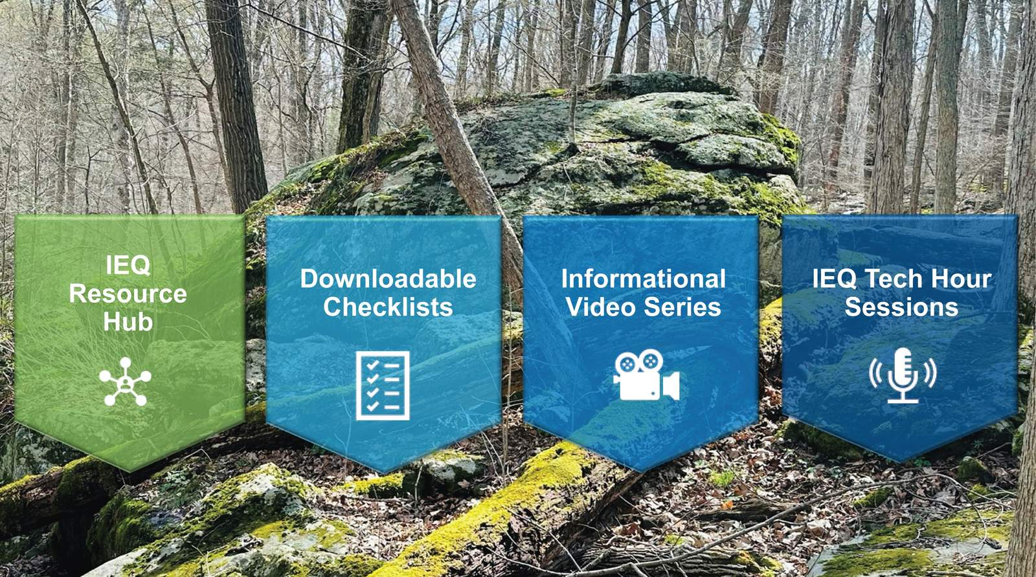
Presidential Initiatives
Resources and Tools
Notes:
Second, we need to make healthy buildings practical and accessible. If indoor environmental quality is going to become central to design and operation, professionals need clear, usable guidance. That’s why we committed to developing a suite of user‑friendly tools and resources – resources that translate science and standards into actions designers, operators, and owners can take today.

Slide 7
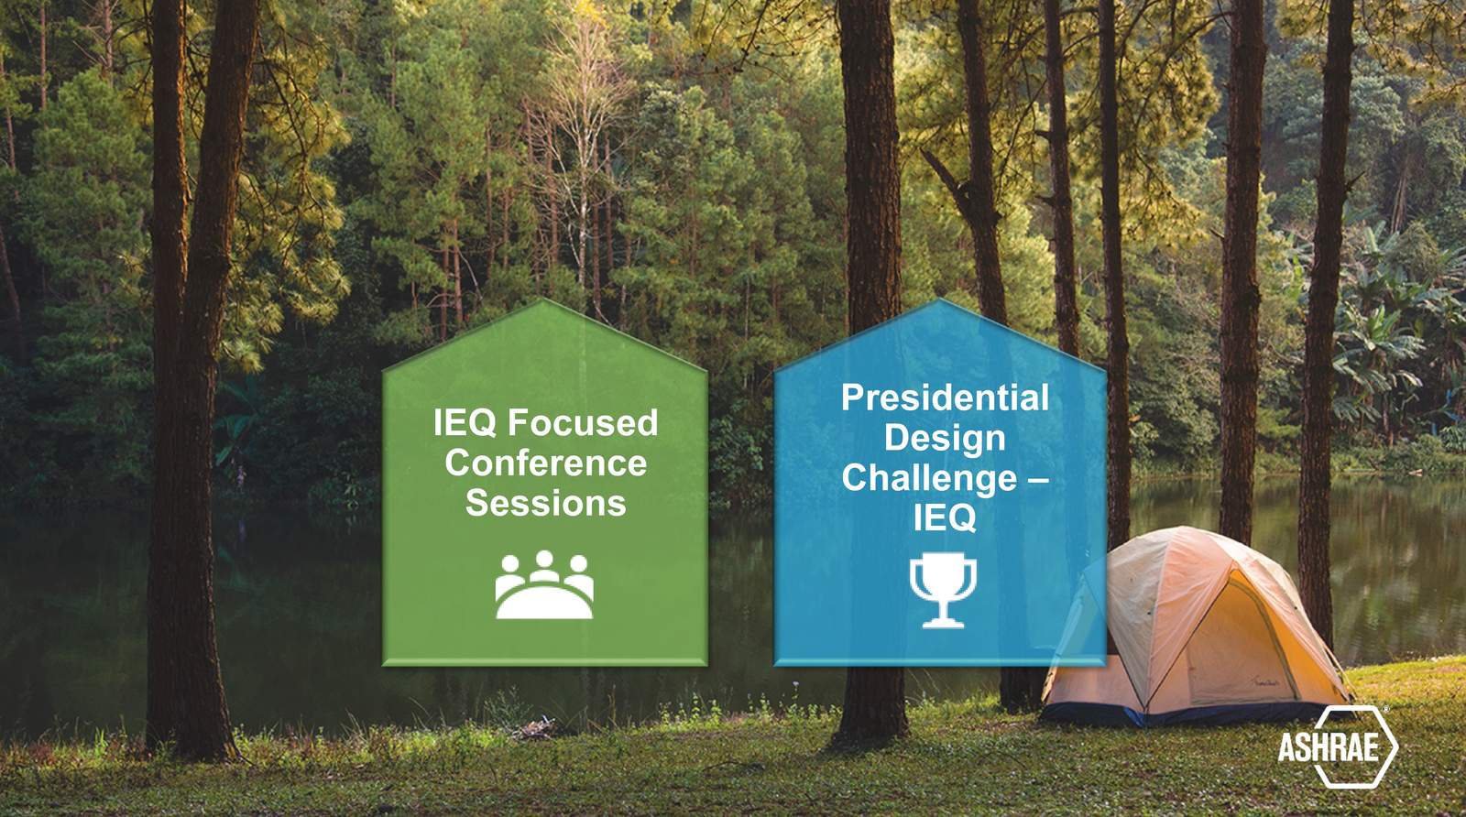
Presidential Initiatives
Collaboration
Notes:
Third, we know we cannot do this work alone. Collaboration is at the core of ASHRAE’s mission. We committed to bringing together experts, policymakers, and practitioners to share knowledge, align efforts, and accelerate progress. Through events like the IEQ 2025 Conference and our Presidential Initiative Challenge projects, we are turning collaboration into meaningful, real‑world impact.

Slide 8

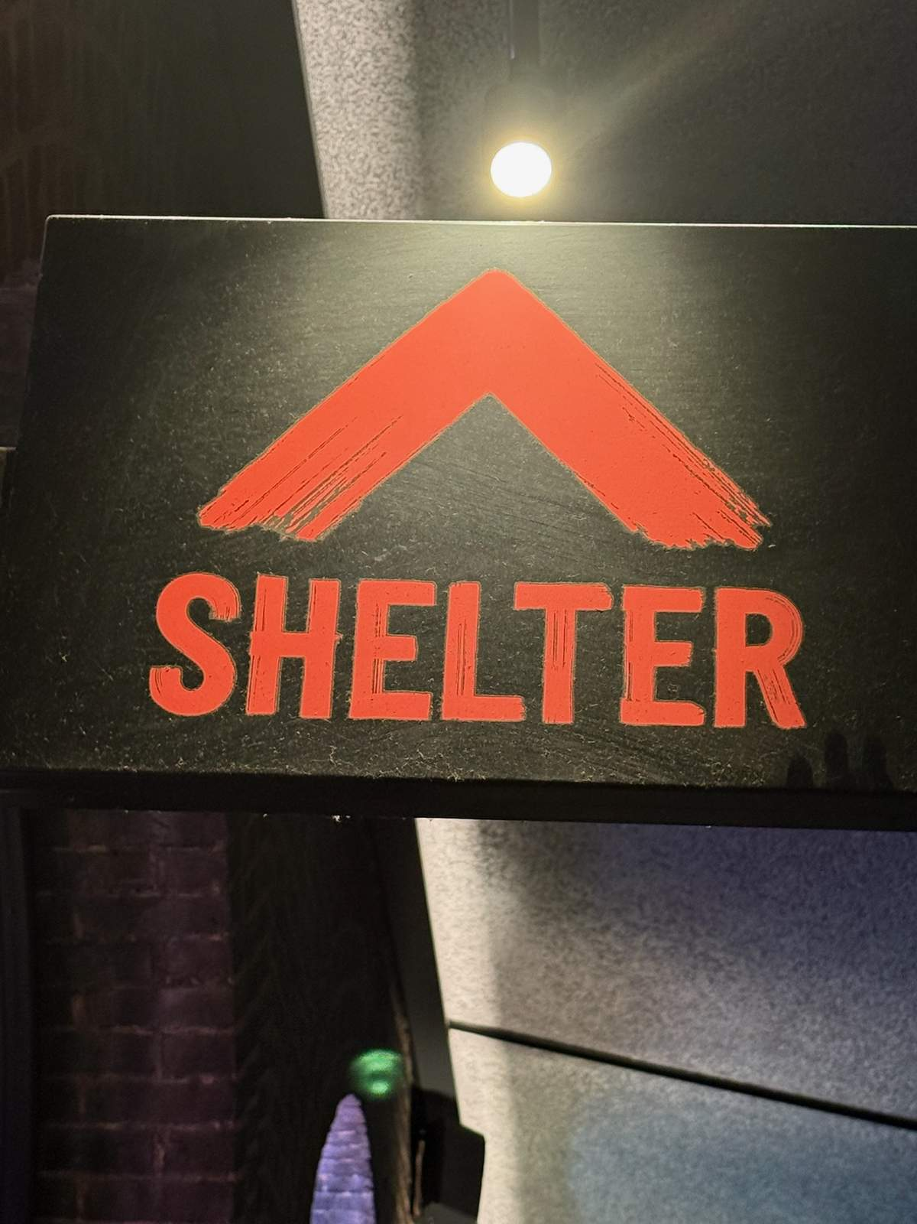
A true shelter includes all aspects of Indoor Environmental Quality:
Air Quality
Lighting
Thermal Comfort
Acoustics
Safe Water
London, England
Notes:
Today, I’d like to share how ASHRAE is turning this vision into action through standards, collaboration, education, and global leadership.
Let’s take a moment to revisit some key elements. A well-designed shelter prioritizes the 5 pillars of indoor environmental quality, all essential for health and comfort and are fundamental to societal advancement and long-term development.

Slide 9

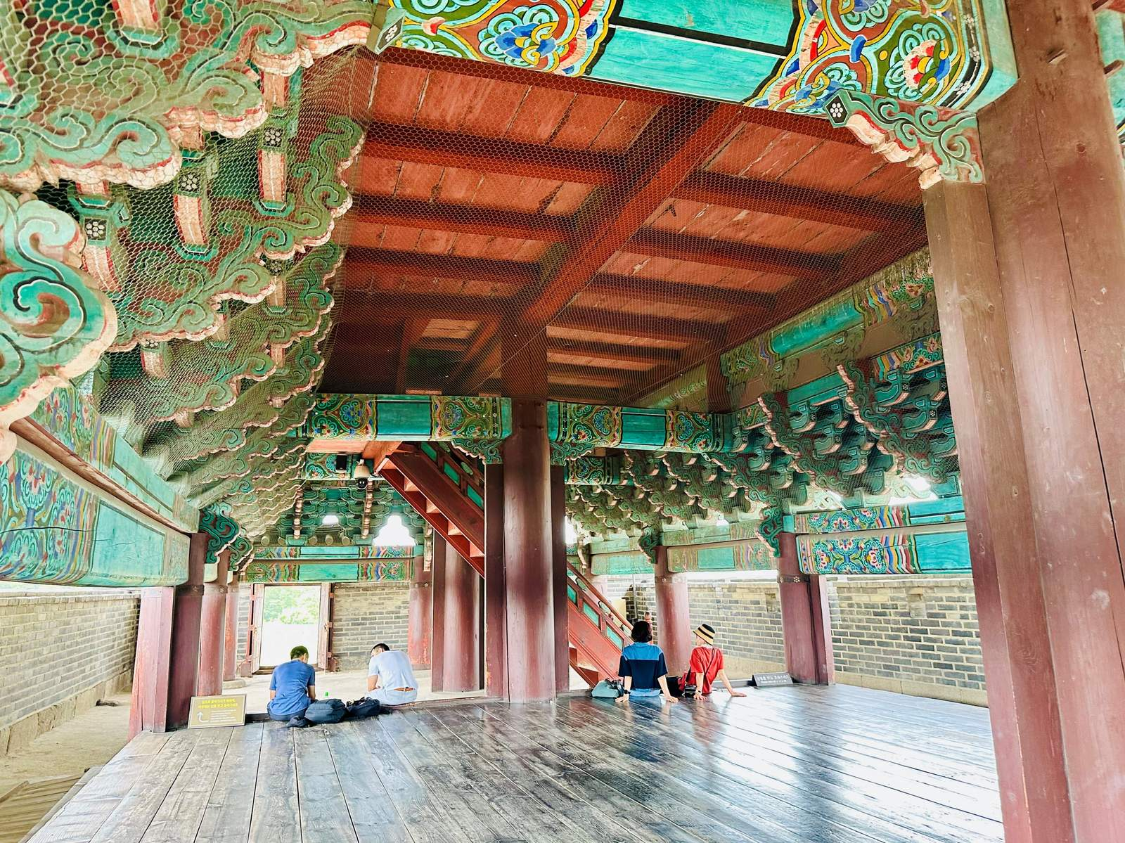
Indoor Air Quality
Effects of poor indoor air quality leads to increased risk of:
Heart disease
Stroke
Lung cancer
Lower respiratory infections
And can be associated with:
Anxiety
Depression
Fatigue
Janganmun Gate, South Korea
Sinoquipe Scout Reservation, Fulton County, PA
Notes:
First, air quality. We each breathe thousands of liters of air every day –90% of it indoors. Poor indoor air quality has profound consequences for human health, from respiratory illness to cardiovascular disease, and it directly affects how we feel, think, and perform.
Clean, well‑ventilated air is not optional. It is foundational to health, safety, and productivity.

Slide 10


Thermal Comfort
Essential to create environments that enhance learning and productivity.
Compliant spaces address temperature and humidity simultaneously.
Notes:
Second, thermal comfort. Comfort matters – especially in the places where we learn, work, and heal.
By addressing temperature and humidity together – starting with good architecture and enclosure design and supported by efficient systems – we can deliver comfortable spaces while minimizing energy use. Comfort and efficiency are not competing goals. They are complementary outcomes of good design.

Slide 11

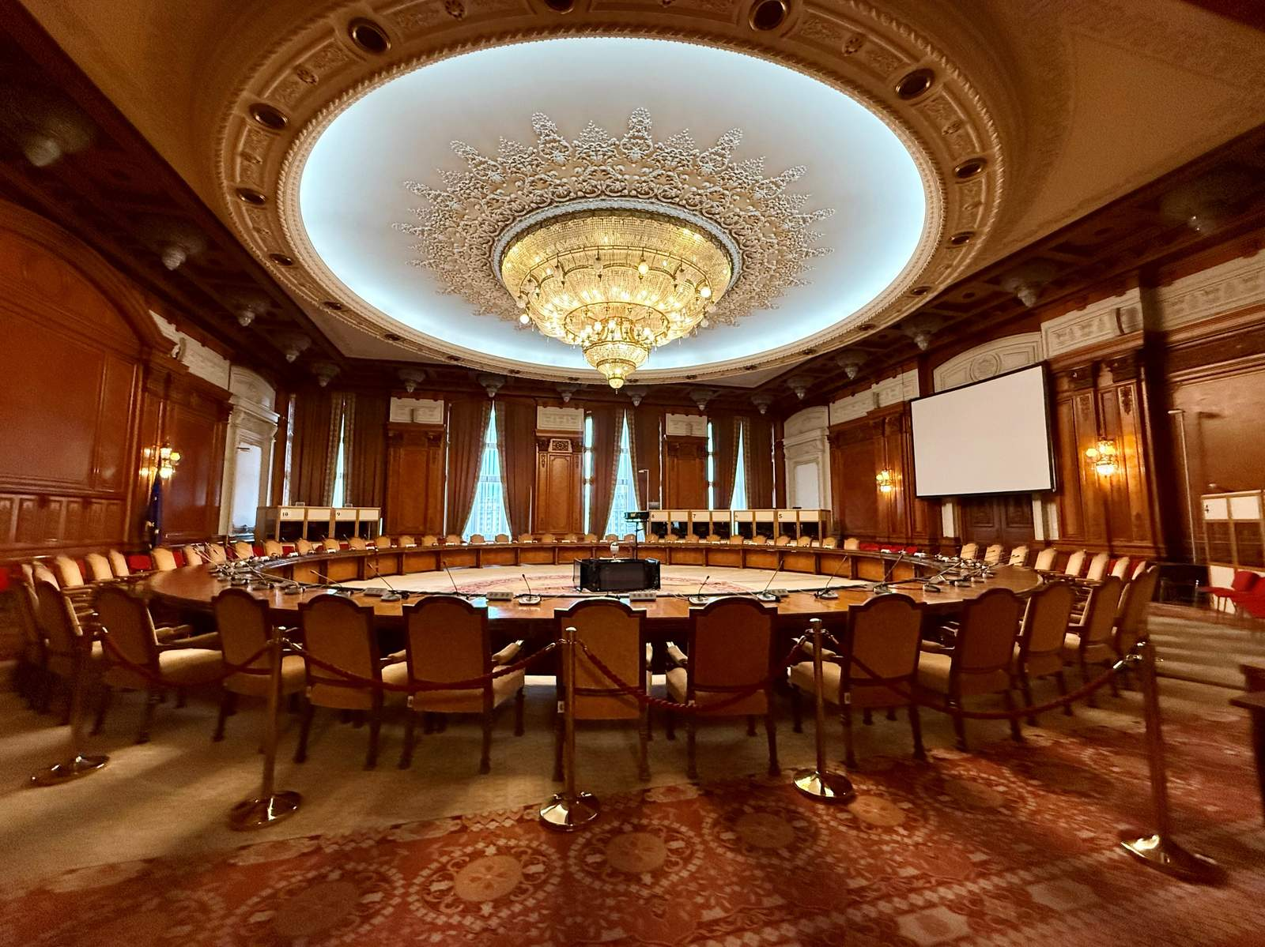
Acoustics
Directly influences occupant comfort, health, and overall productivity.
Poor acoustic design leads to discomfort, stress, and low productivity.
Bucharest, Romania
Notes:
Third, acoustics. Sound quality has a powerful impact on comfort, focus, and well‑being.
Poor acoustic design leads to distraction, stress, and reduced performance. Thoughtful acoustic design, on the other hand, supports concentration, communication, and productivity across offices, schools, and homes.

Slide 12


Lighting
Proper lighting is crucial to:
Support circadian rhythm
Enhance sleep quality
Support biological function
Help mitigate fatigue, stress and mood disorders
Phoenix, Arizona
Notes:
Fourth, lighting and daylighting. Light shapes how we sleep, how we feel, and how we function.
Well‑designed lighting supports healthy circadian rhythms, reduces fatigue, and enhances cognitive and emotional well‑being. It is a critical contributor to both comfort and performance.

Slide 13


Water Quality
Contaminated water supply cause respiratory and gastrointestinal diseases and long-term illness.
Waterborne diseases are the result of:
Aging infrastructure
Improper water treatment practices
Reduced flow devices
Notes:
And fifth, water. Too often overlooked, water quality is a critical component of building health.
Aging infrastructure, improper treatment, and increased water age in building systems have led to rising cases of waterborne disease. Safe, well‑managed water systems are essential to protecting occupants and maintaining trust in the built environment.

Slide 14
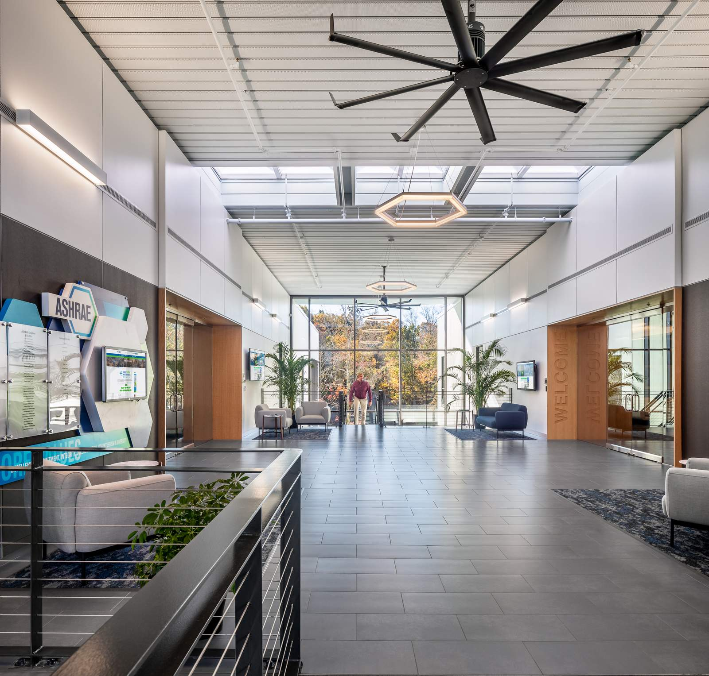

Balancing energy efficiency with good IEQ
ensures that buildings are not only environmentally sustainable but also conducive to the health and productivity of their occupants, creating a
win-win situation for both people and the planet.
ASHRAE Global Headquarters, Peachtree Corners, GA
Notes:
To be truly healthy, a building must address all five pillars – together.
Neglecting any one of them undermines occupant health and compromises the building’s purpose. That’s why our work this year – developing a roadmap, identifying best practices, providing practical tools, and strengthening collaboration – is so critical to delivering meaningful, lasting impact.

Slide 15

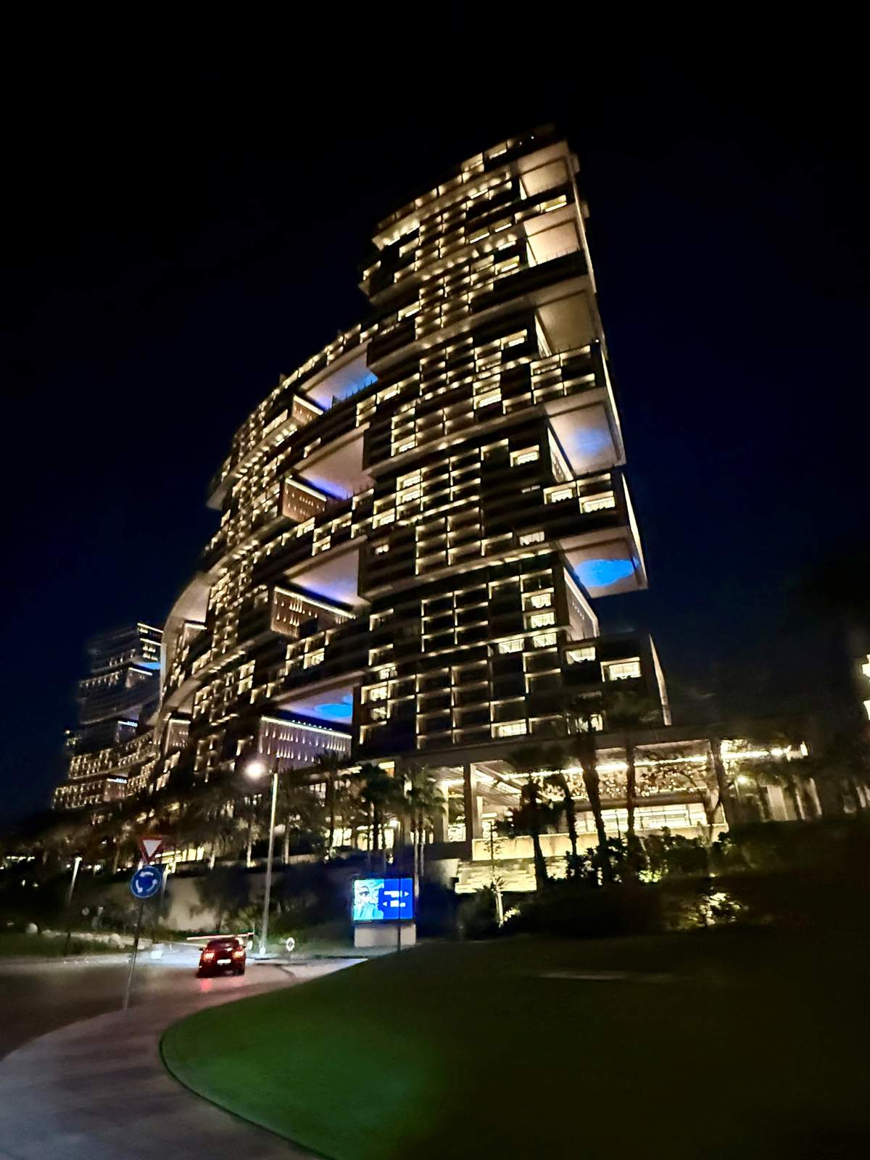
Center of Excellence IEQ
Create a multi-year road map
Monitor issues and trends
Coordinate joint initiatives, events,
projects with similar organizations
Guide our efforts to influence public policy, advocacy and outreach
Coming soon to ashrae.org!
Dubai, UAE
Notes:
We are now six months into this journey, and the progress is real.
To ensure this work moves beyond vision and into sustained action, Presidential Member Dennis Knight and I convened a presidential ad hoc committee, chaired by former ASHRAE Vice President Wade Conlan. That work led to a unanimous Board vote in November to establish the Center of Excellence IEQ – a dedicated platform to create and advance the roadmap, coordinate collaboration, and guide ASHRAE’s leadership in policy, advocacy, and global outreach.

Slide 16
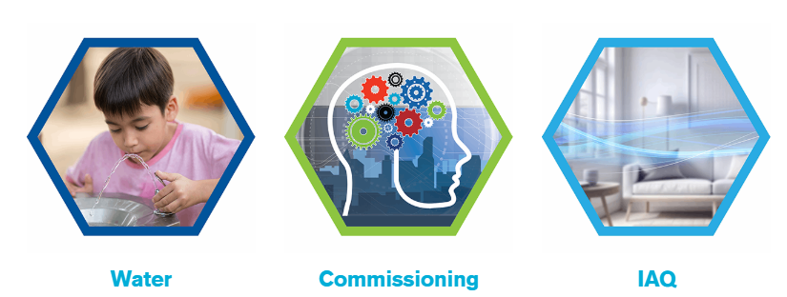

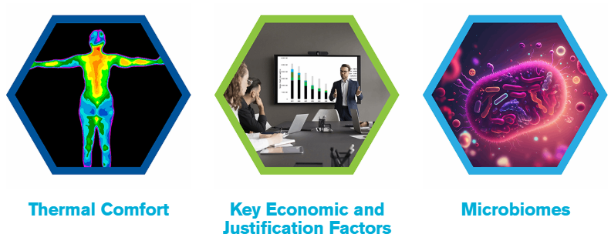
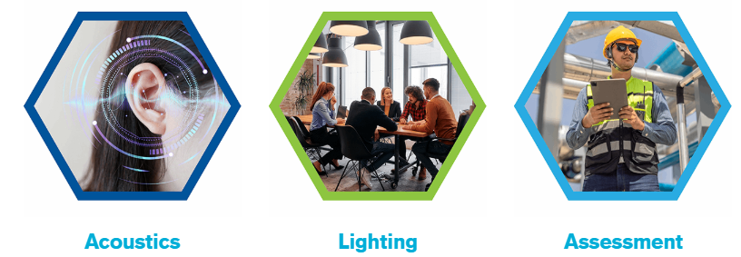
IEQ Resources
ashrae.org/ieq-resources
12 Videos
Topic Overview Guides
Checklists
References
Notes:
On July 1, we took a key step forward with the launch of ASHRAE’s IEQ resource page. Since then, it has been steadily populated with practical documents, presentations, videos, and tools, organized around each of the five IEQ pillars, to help professionals apply healthy building principles in real‑world settings.

Slide 17


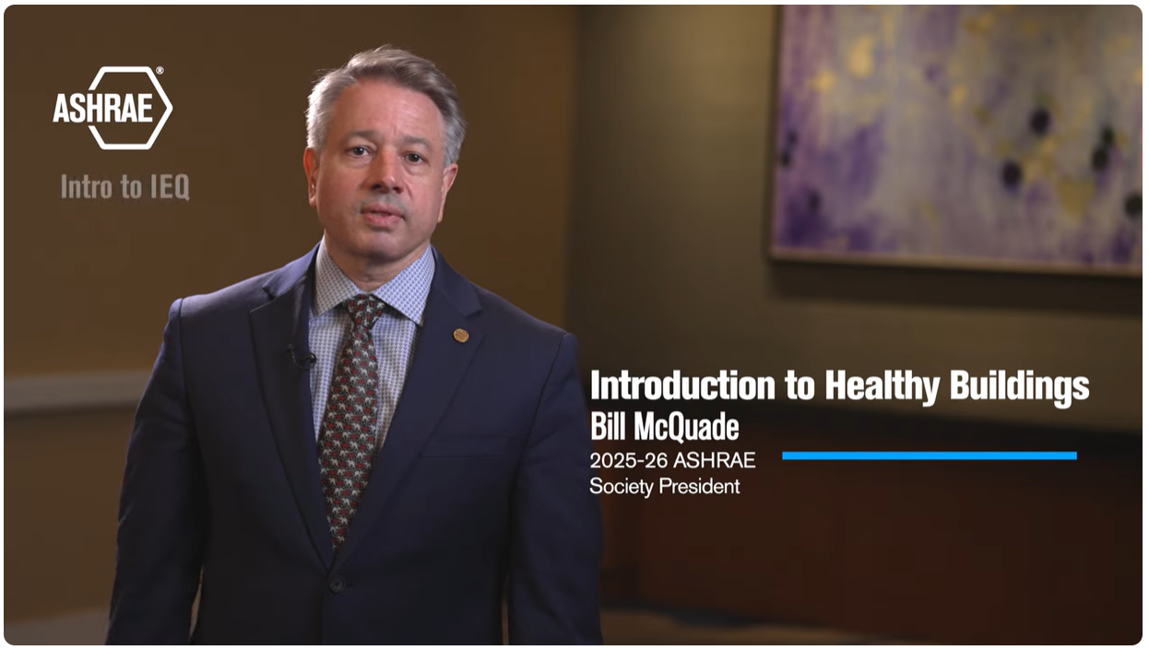


IEQ Video Series includes 12 videos covering IEQ pillars at ASHRAEvideo on YouTube and ashrae.org/president.
Now Available!
Tech Hour #9: IEQ – Codes, Impact on People, and Considerations (IAQ, Thermal Comfort, Lighting, Acoustics)
Coming in March
Tech Hour #10: Water
Notes:
Education is central to impact. Our IEQ video series has already reached more than 130,000 viewers, helping designers, operators, owners, and facility managers better understand what healthy buildings require.
We are also developing downloadable IEQ checklists to support both new and existing buildings.
I’m pleased to share that our first IEQ Tech Hour session is now live. IEQ-Codes, Impact on People, and Considerations brings indoor environmental quality to life by exploring how indoor air quality, thermal comfort, lighting, and acoustics directly influence the health, comfort, and performance of building occupants. This session goes beyond theory, showing how existing codes and guidelines can be applied today to design and construct buildings that better serve our communities. It also highlights where research points to opportunities for optimizing performance to better meet occupant needs and expectations, and how each of us can play a role in creating truly high-performing spaces.
I encourage you to watch this Tech Hour through the ASHRAE 365 app and to stay tuned for our next Tech Hour in March, which will focus on water systems and their critical role in building health.

Slide 18

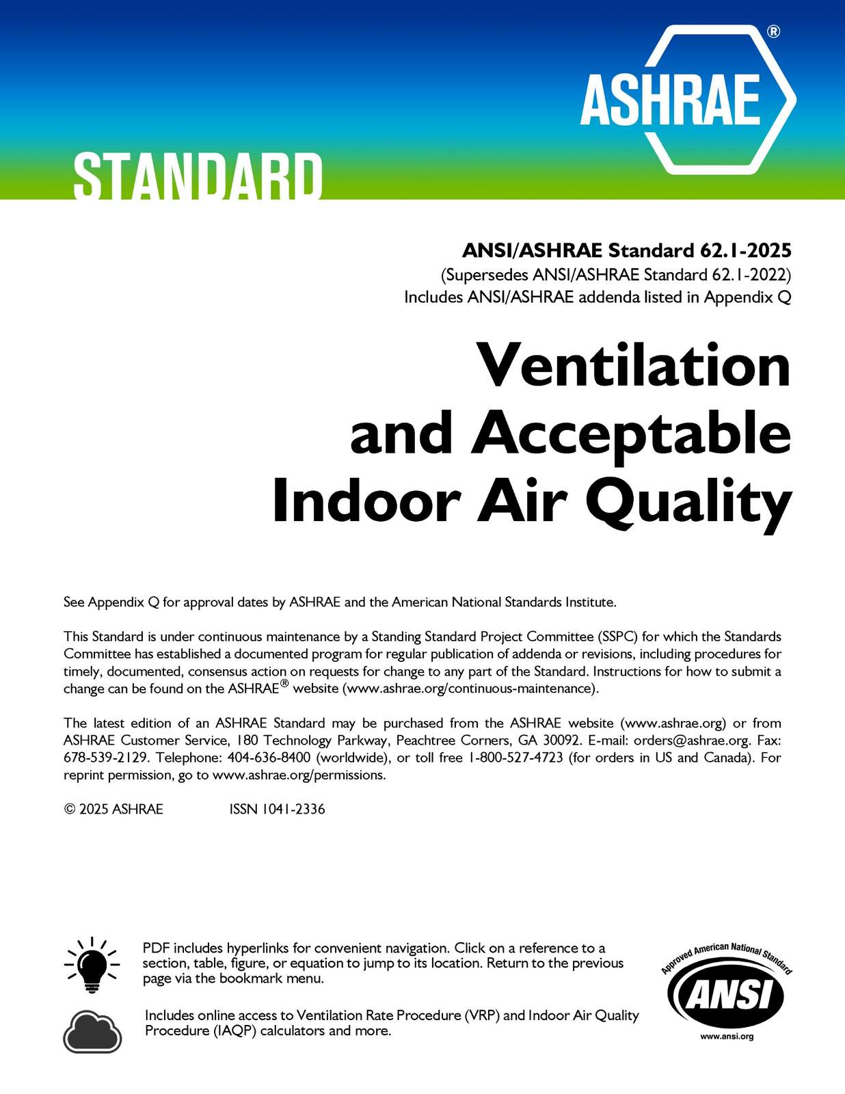
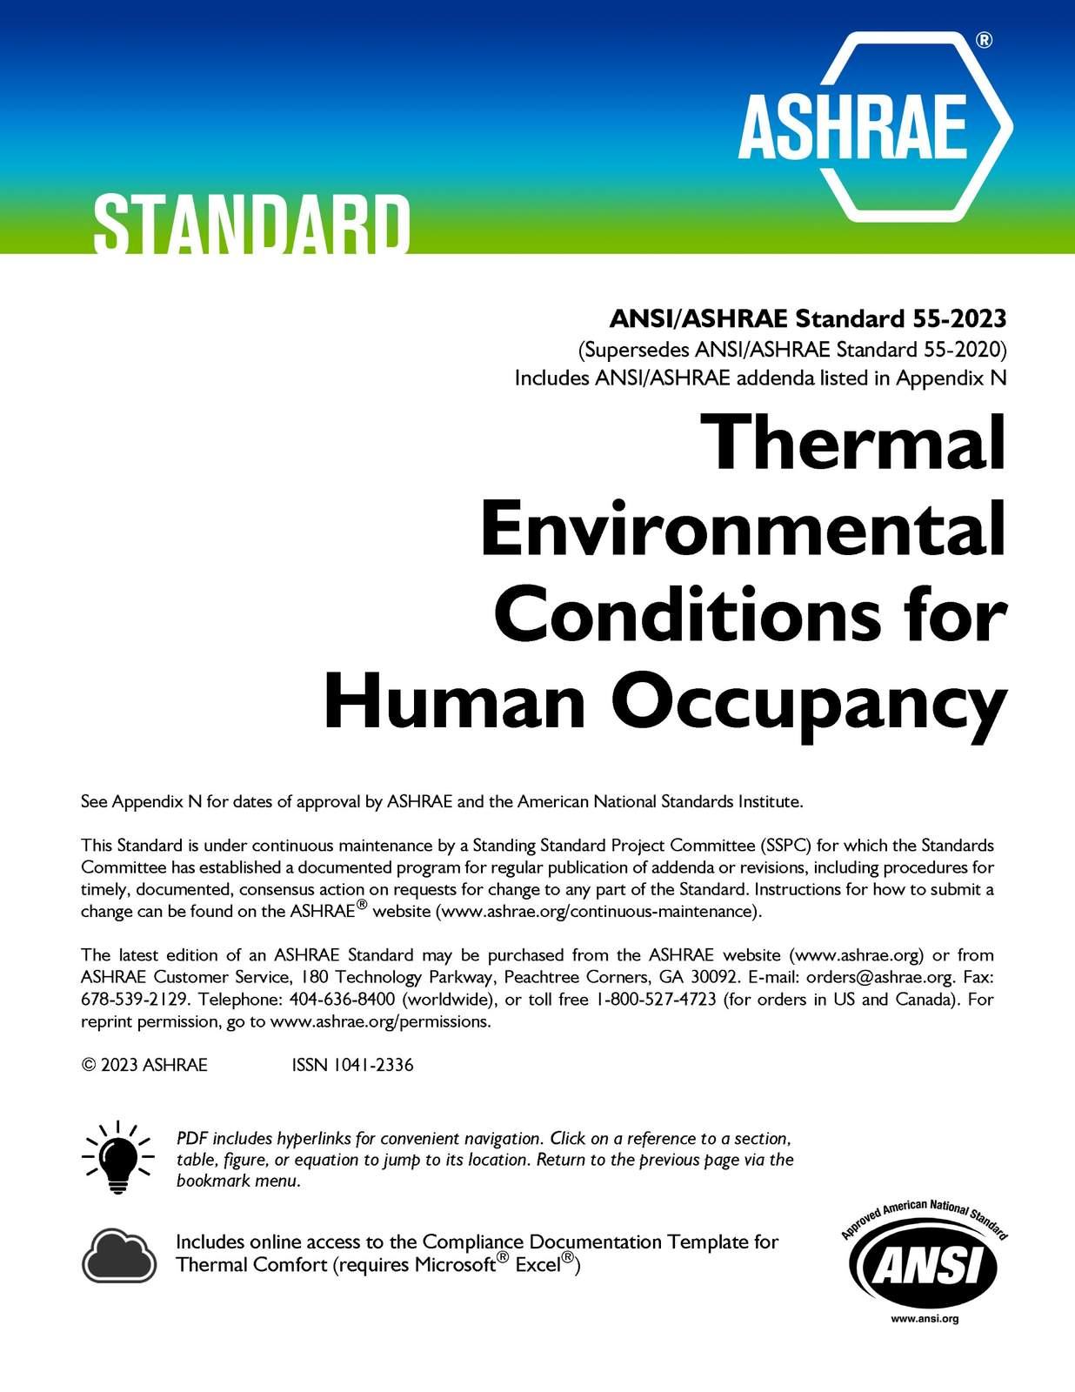
Notes:
ASHRAE’s standards continue to anchor this work. In December, we released the latest edition of Standard 62.1, Ventilation for Acceptable Indoor Air Quality, with enhanced guidance on inspections, humidity control, and emergency operations.
Standard 55, now in its 60th year, remains a globally referenced framework for achieving thermal comfort while balancing energy efficiency. Together, these standards translate science into practice, helping to deliver healthier, more resilient buildings around the world.

Slide 19
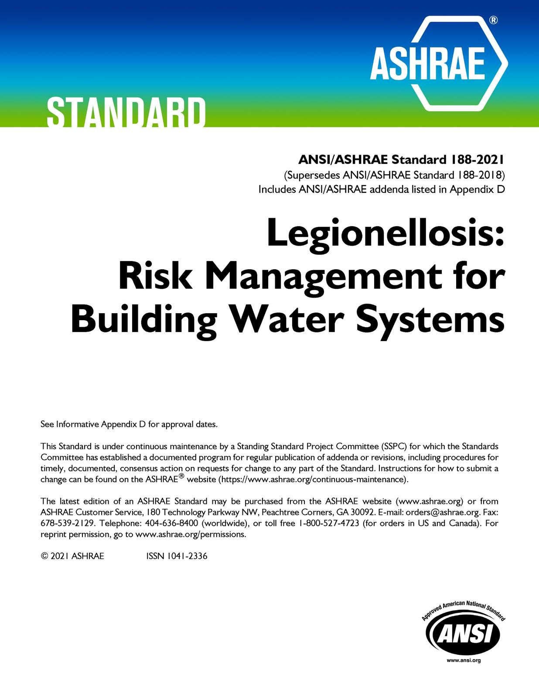

Meeting with BOMA, NIBS, and U.S. policy makers, Washington D.C.
Notes:
ASHRAE’s leadership in water safety is both technical and urgent. Compliance with Standard 188, Legionellosis: Risk Management for Building Water Systems, and Guideline 12 has long been required in healthcare settings—yet cases of Legionella continue to rise in commercial and residential buildings across many states.
Recent outbreaks have made one thing clear: preventing Legionella requires a comprehensive, source‑to‑tap approach that addresses both municipal water systems and building design and operation.
That’s why New Jersey has enacted legislation requiring compliance with ASHRAE Standard 188 – and why similar efforts are now underway in New York, Maryland, and Pennsylvania.
This is a moment for leadership. I urge policymakers, owners, designers, and operators to adopt and implement these standards – not after an outbreak, but before one occurs. Protecting public health depends on a comprehensive approach, proactive action, informed by science and guided by ASHRAE.

Slide 20




Add Photos of travel to Tokyo, Dubai, Italy, Ecuador
Notes:
As I’ve traveled over the past six months, one message has been consistent: improving indoor environmental quality is now a global priority. From Tokyo to Dubai, from Italy to Ecuador, leaders are focused on balancing occupant well‑being with energy efficiency and carbon reduction.

Slide 21
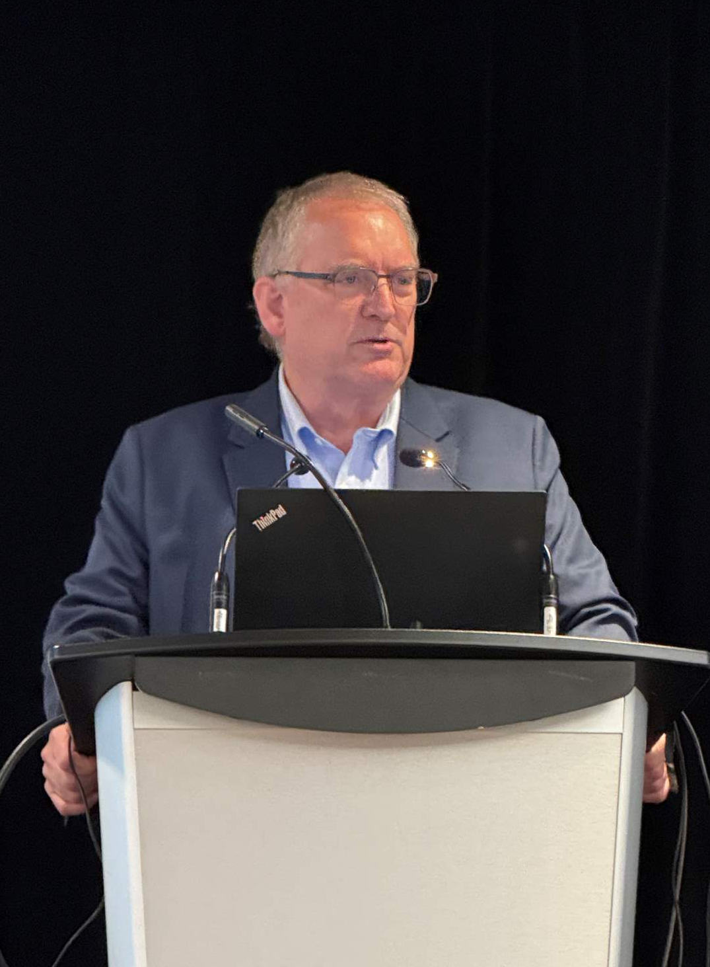

Presidential Member Dr. Bill Bahnfleth
Global Pledge for Healthy Indoor Air, New York City
Notes:
What I’ve seen around the world is more than interest – it’s commitment. Since July 1, ASHRAE and its members have been turning that commitment into action, building partnerships and advancing solutions that deliver real impact.
ASHRAE engaged with the National Academies Health in Buildings Roundtable, providing leadership in the Ventilation Workshop and representing pathogen mitigation Standard 241.
We partnered with IWBI and USGBC to launch the Global Commission on Healthy Indoor Air, uniting leaders from more than 30 countries to develop a global framework for action and national blueprints for IAQ advancement.
ASHRAE joined more than 150 organizations in signing the Global Pledge for Healthy Indoor Air, reinforcing a shared commitment to healthier indoor environments worldwide.

Slide 22



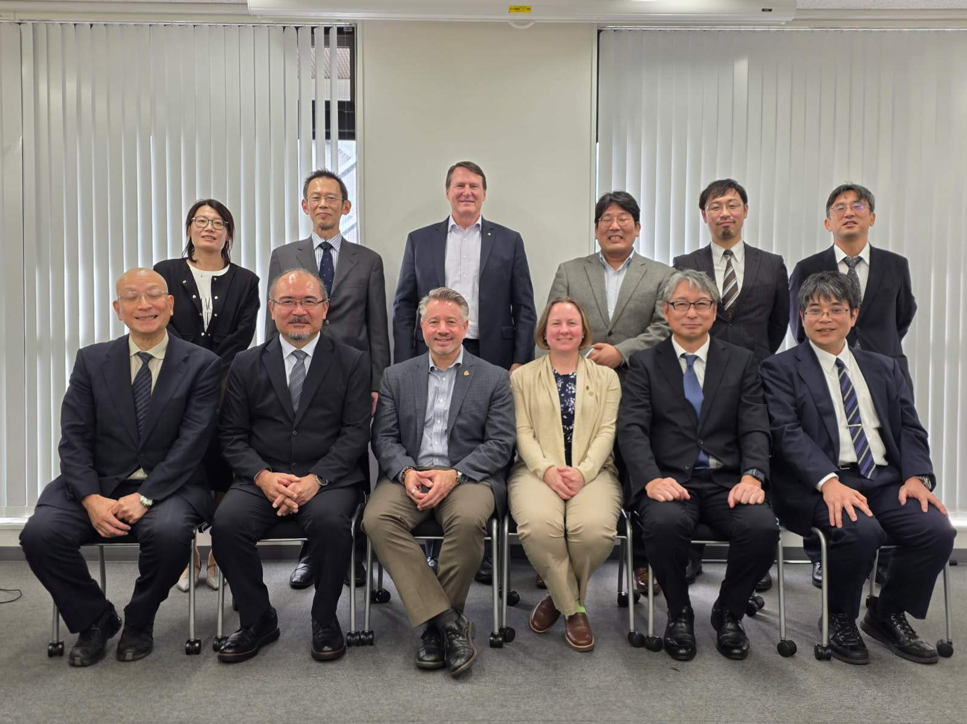
CIBSE,
London
SHASE, JSRAE, ASHRAE Meeting, Japan
Notes:
And that collaboration doesn’t stop with formal initiatives. It extends to a growing network of global and regional partners – organizations that share our commitment to indoor environmental quality, decarbonization, and resilience, and that are looking to ASHRAE to help bring those efforts together.
We have met with the leadership of global and regional industry associations and organizations like AIIR, CIBSE, REHVA, IIAR, SHASE, JSRAE, ISHRAE, USGBC, IWBI, and AIHA. All of whom have prioritized indoor environmental quality as well as decarbonization and resilience. All of whom have expressed an interest in having ASHRAE act as an organizer and convener for global collaboration.
We’re seeing this collaboration take shape not just in commitments, but in practice.

Slide 23
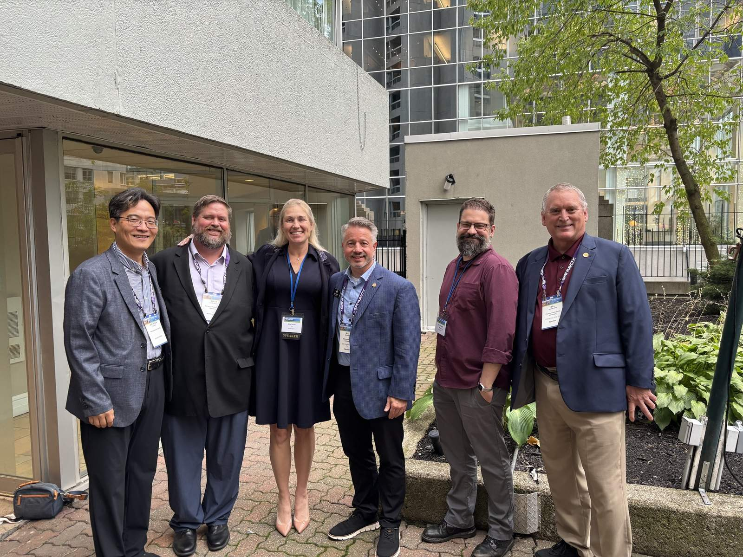

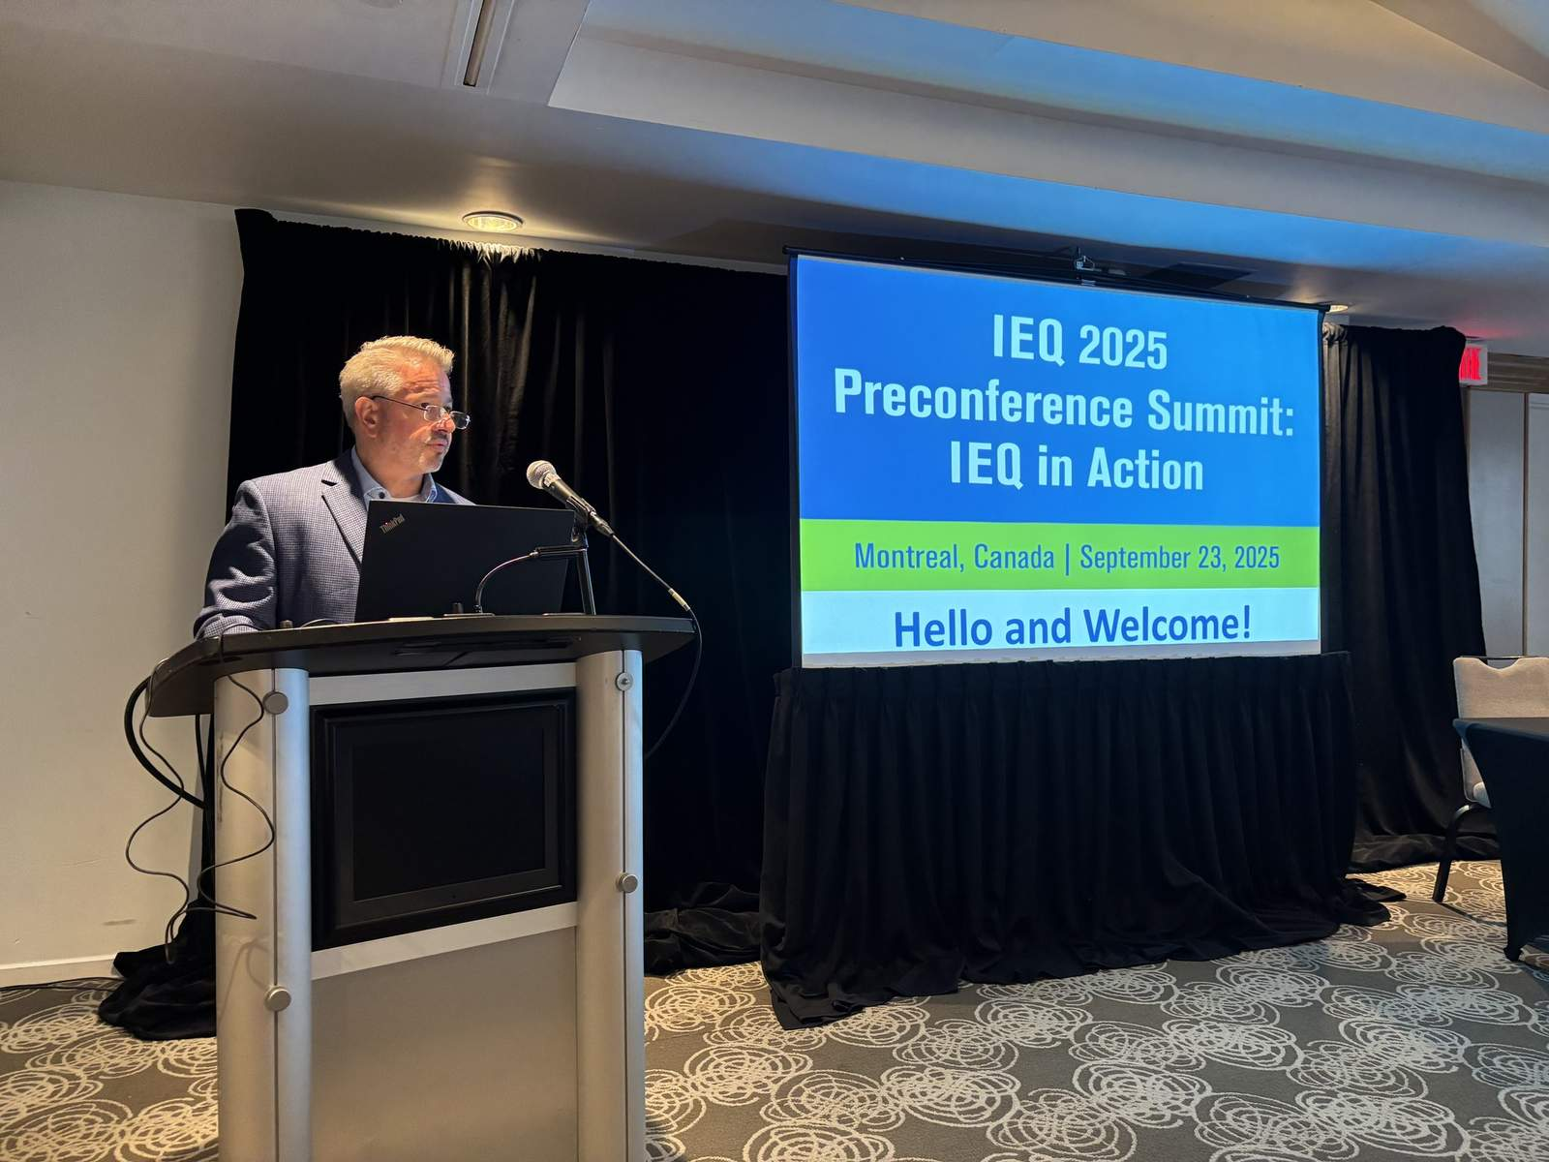
2025 ASHRAE IEQ
Conference, Montreal
Notes:
The ASHRAE IEQ 2025 Conference demonstrated what’s possible when science, practice, and policy come together. Our pre-conference event saw 55 participants and focused on solutions for specific applications like schools and eldercare centers and emerging issues such as wildfire smoke and source water quality.
The main conference welcomed 312 participants from 28 countries, spanning government, industry, academia, and building ownership, to share real‑world applications and lessons learned.
Practitioners presented case studies applying Standard 241 in occupied buildings, showing measurable benefits for both human health and energy performance. These conversations are already informing policy discussions at the local and national levels.
Those conversations don’t stay in conference rooms. They are increasingly focused on public health outcomes.

Slide 24


Water Wellness Summit 2025, Washington D.C.
Notes:
In October, I participated in the Alliance to Prevent Legionnaires’ Disease Water Wellness Summit in Washington, D.C., where I spoke on the importance of a comprehensive “source-to-tap” approach to Legionella prevention and the critical role of ASHRAE Standard 188, Standard 514, and Guideline 12 in protecting building occupants from waterborne disease.
One key takeaway was the opportunity to reduce water volume in building systems through right‑sized piping – lowering both the risk of waterborne disease and the energy required to maintain safe water temperatures. Practical design decisions can deliver meaningful public‑health benefits.
As those lessons emerge, they are shaping a broader policy conversation.

Slide 25
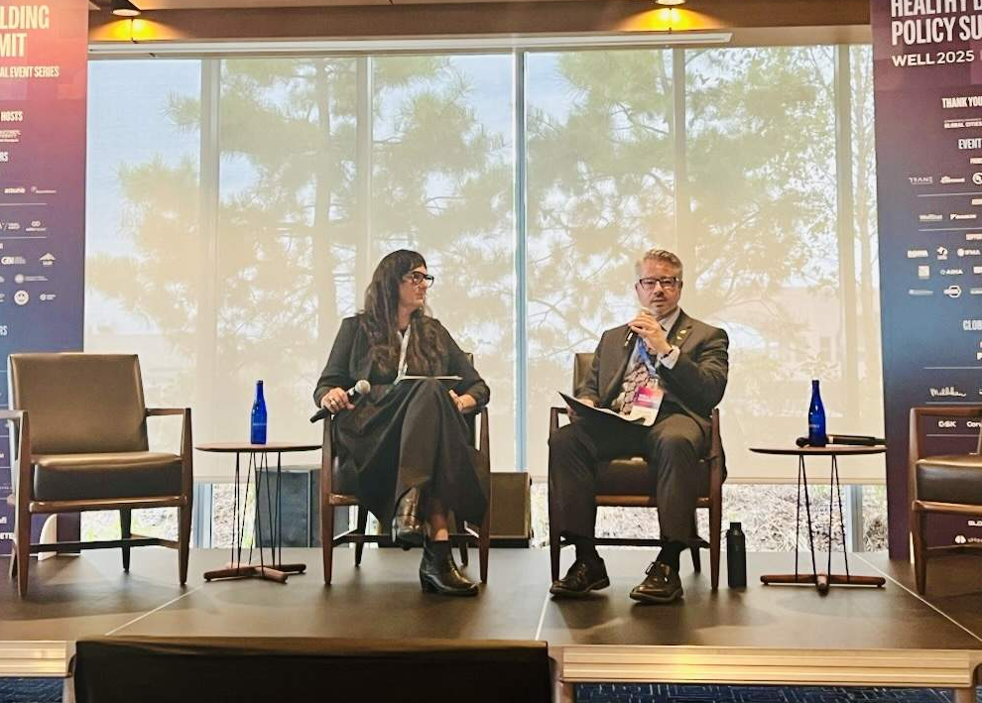
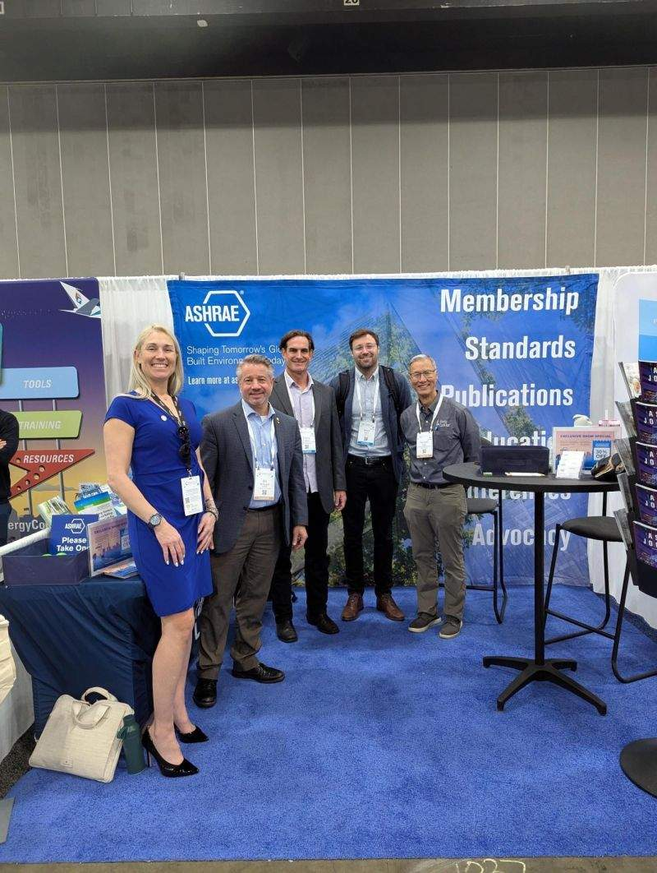

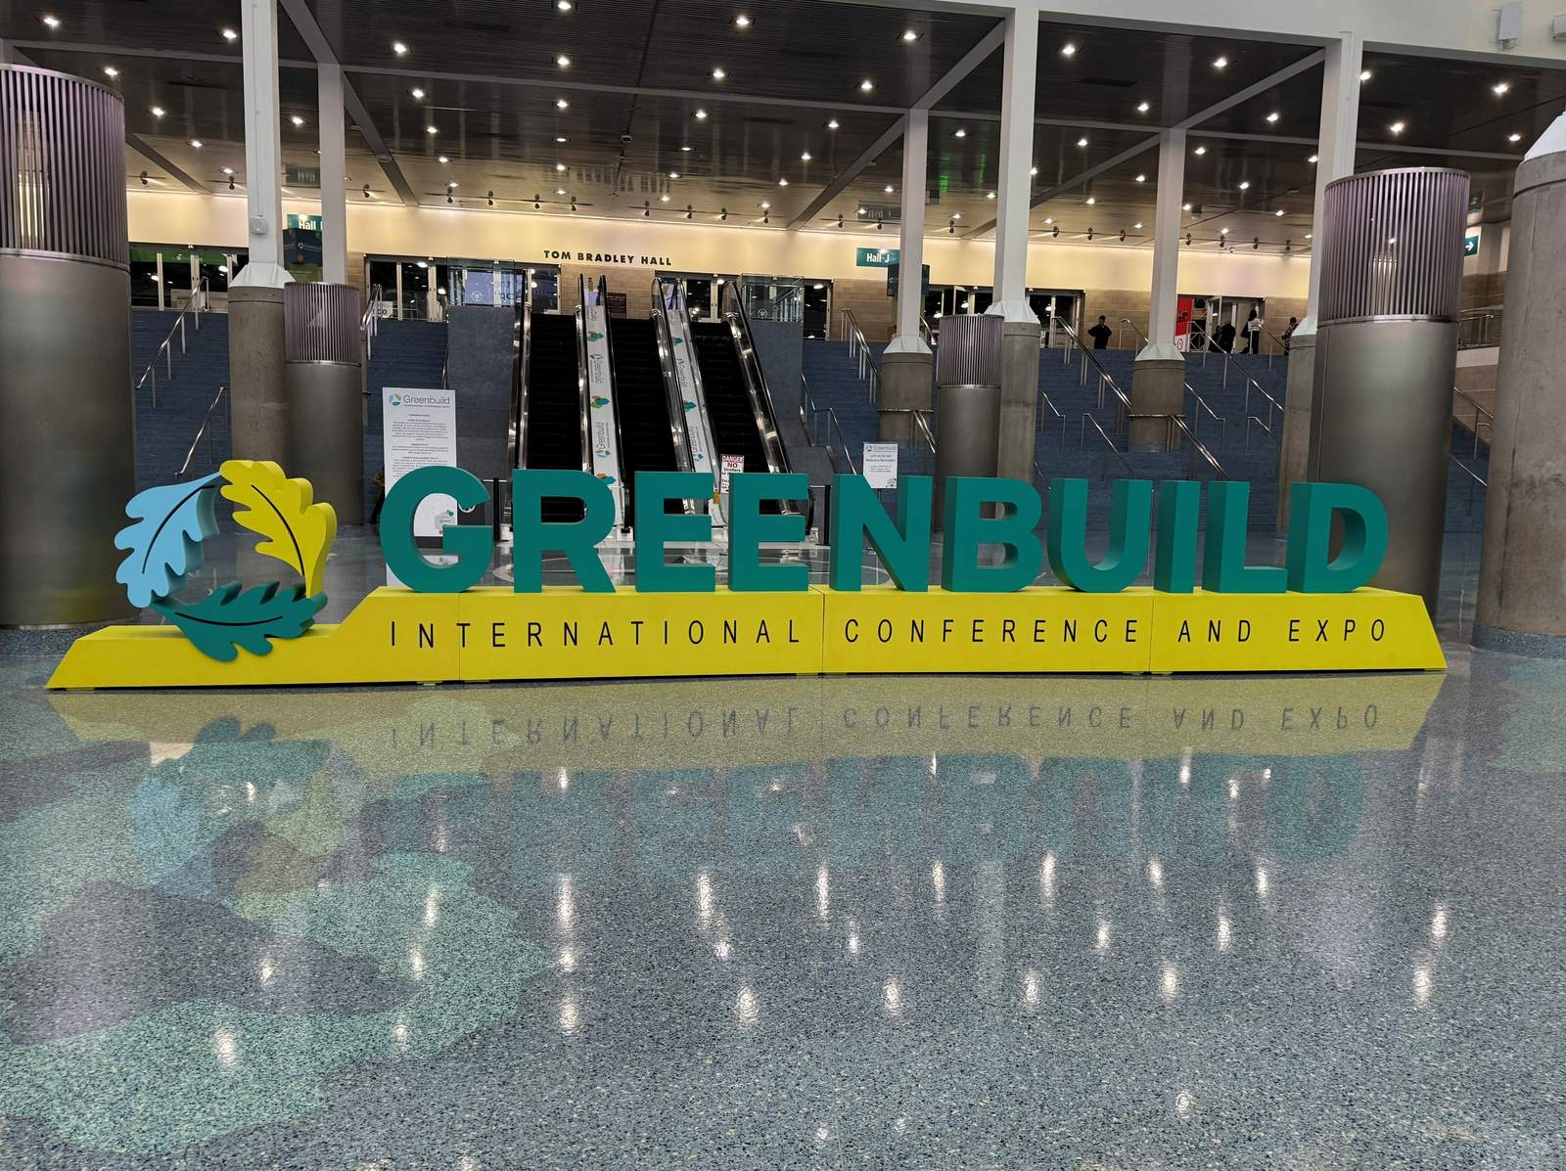
Healthy Buildings Policy Summit, Washington D.C.
Greenbuild, Los Angeles
Notes:
I also attended the Healthy Building Policy Summit in Washington, D.C., organized by the Georgetown University Global Cities Initiative in collaboration with the International WELL Building Institute. The summit convened academic researchers, policymakers, government officials, industry leaders, and public health experts to advance dialogue and action around healthy building policy. I participated in an on-stage fireside chat, where I discussed my presidential theme and emphasized the importance of identifying a strong nexus between energy efficiency and indoor environmental quality in both new construction and building retrofits.
At Greenbuild 2025 in Los Angeles, I delivered a keynote at the Healthy Spaces for All Summit. This event focused on raising awareness of the impacts of the built environment on human health and promoting strategies to enhance occupant well-being. It highlighted how buildings affect not only occupants but also workers and neighboring communities, reinforcing the importance of creating spaces that are safe, inclusive, and accessible for all, an approach that directly aligns with Healthy Buildings: Designing for Life and ASHRAE’s vision of a healthy and sustainable built environment for everyone.
And this work is not limited to one region or one market – it’s global.

Slide 26
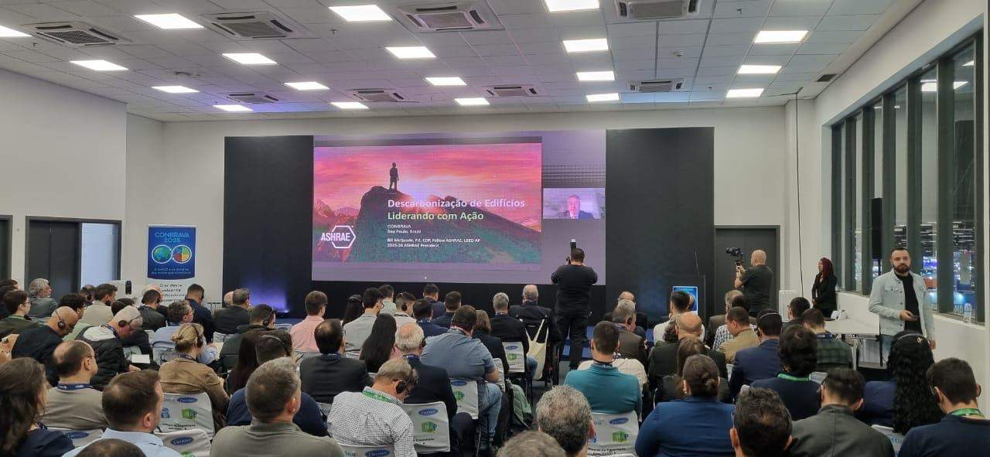


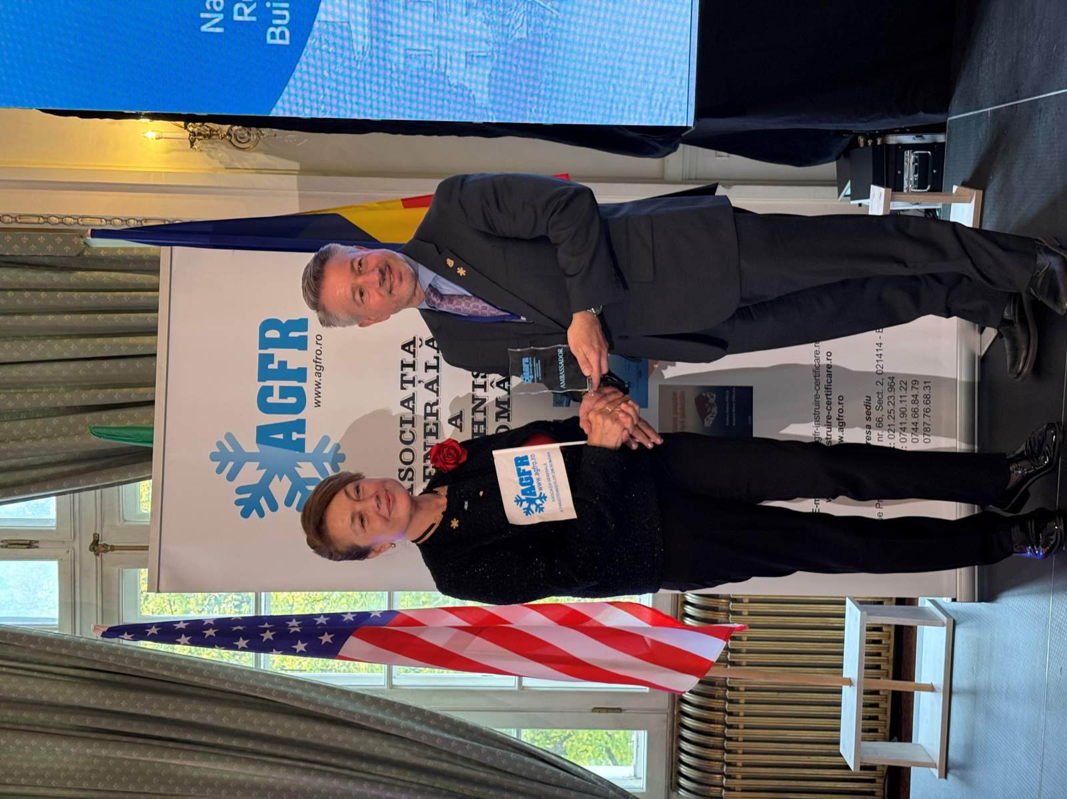
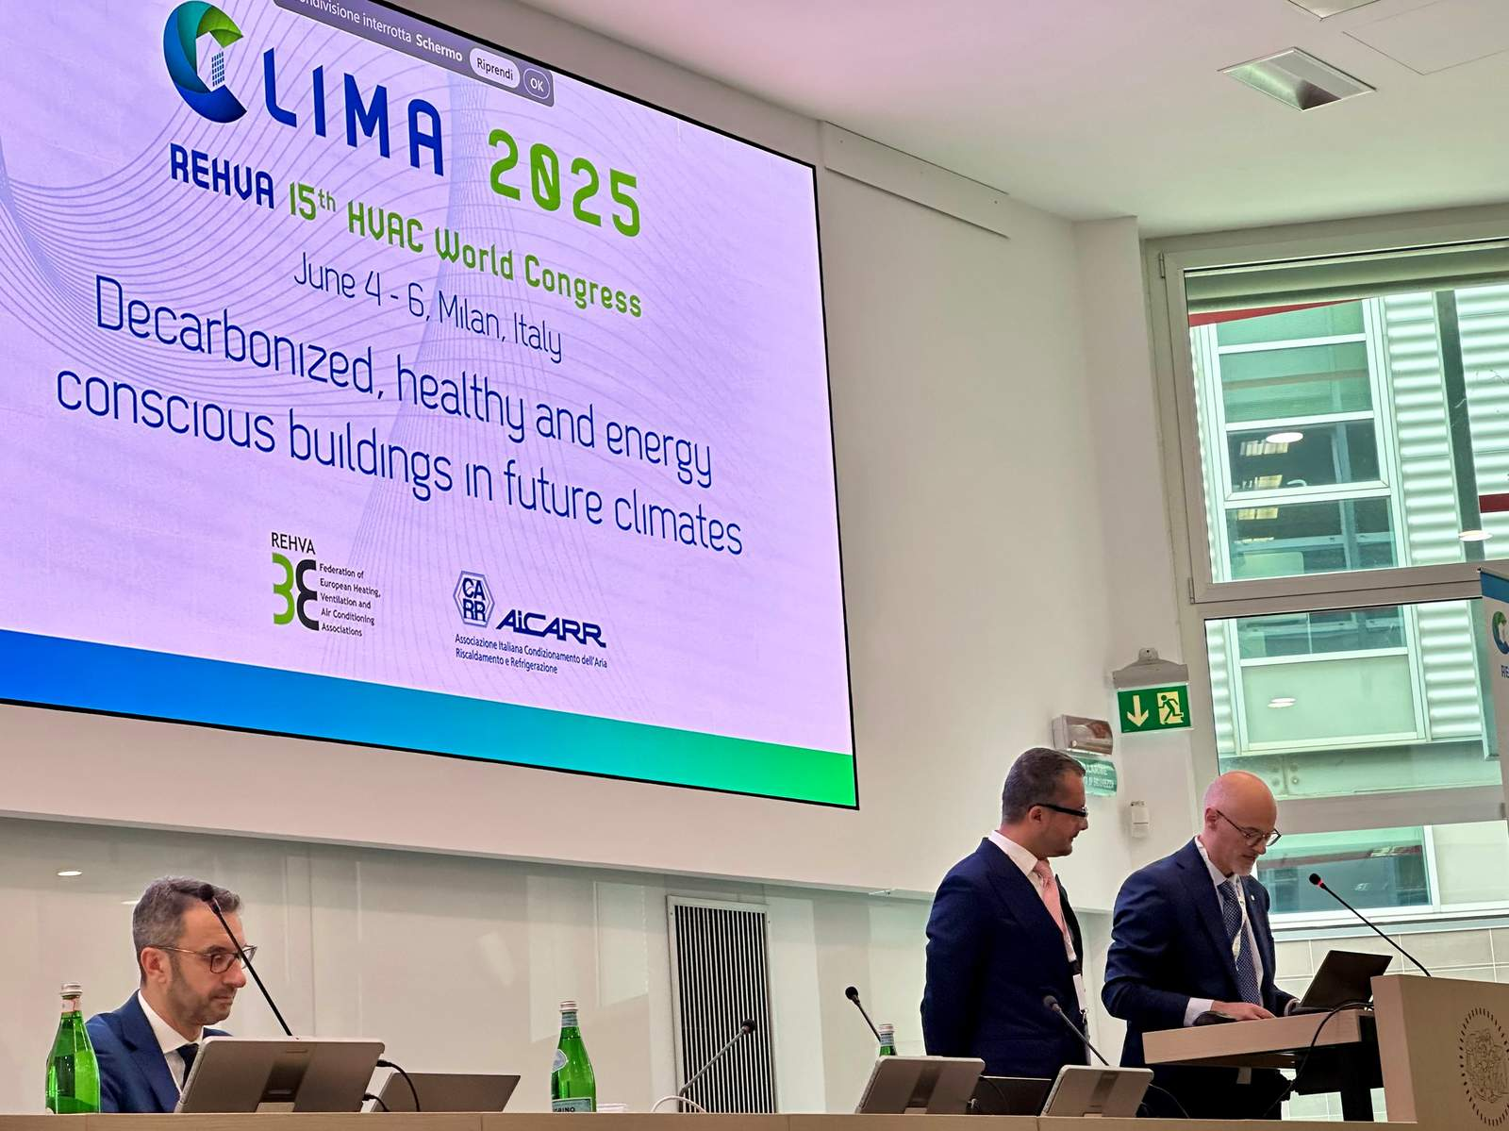
Notes:
Throughout the year, I continued to share ASHRAE’s integrated approach to health‑focused building design through keynote presentations across Europe, South America, and beyond.
From São Paulo to Milan to Romania, the message resonated: healthy buildings require coordinated action across design, operation, and policy – and ASHRAE is uniquely positioned to lead that conversation globally.
That global dialogue is mirrored by conversations across our industry.

Slide 27

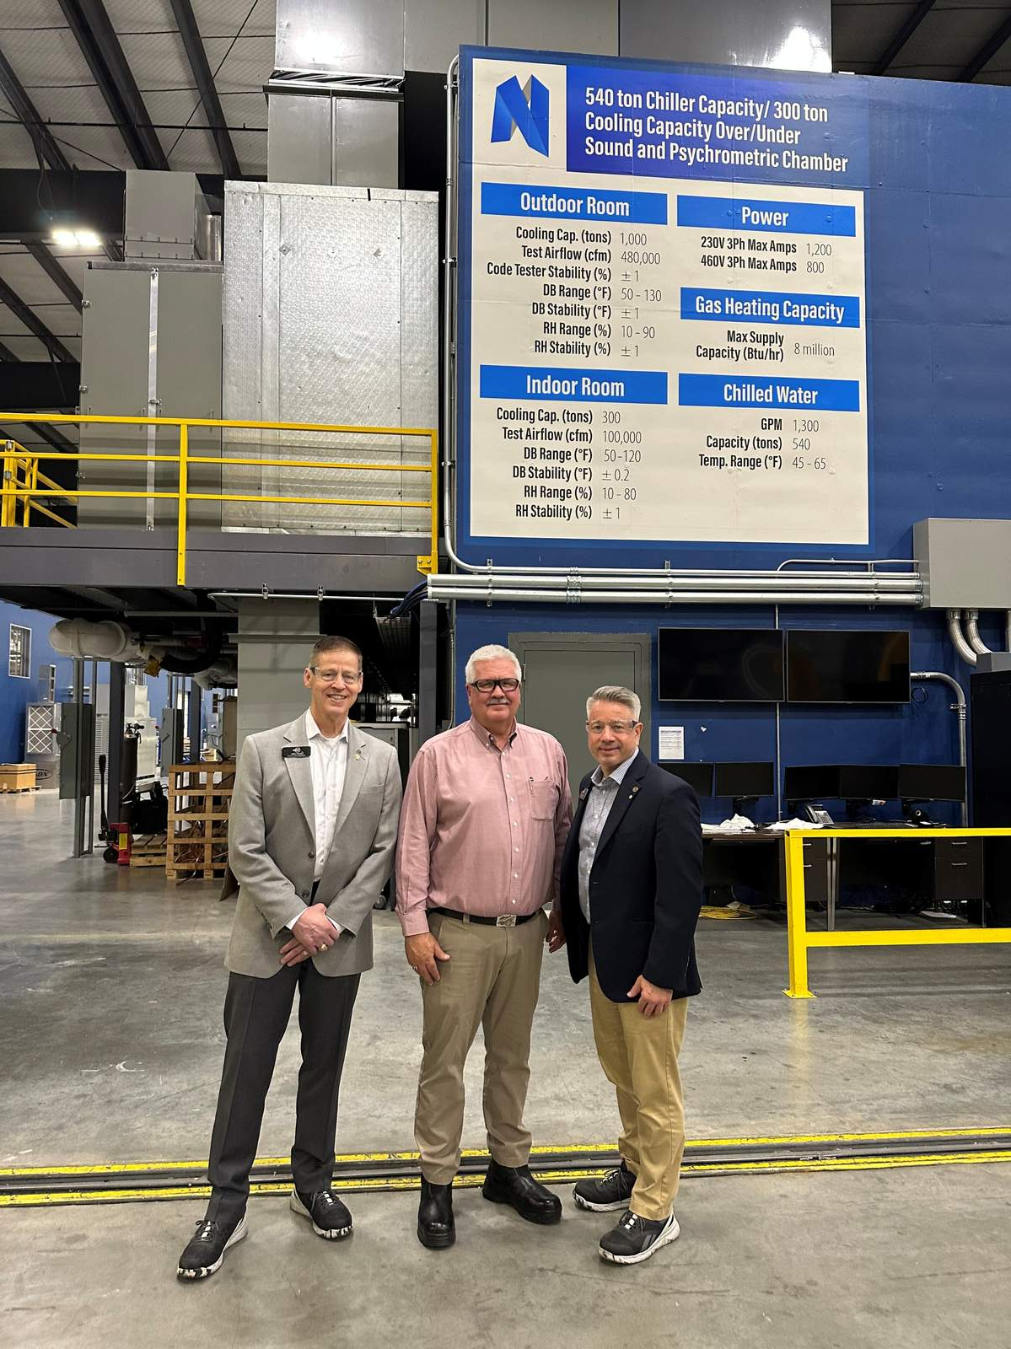
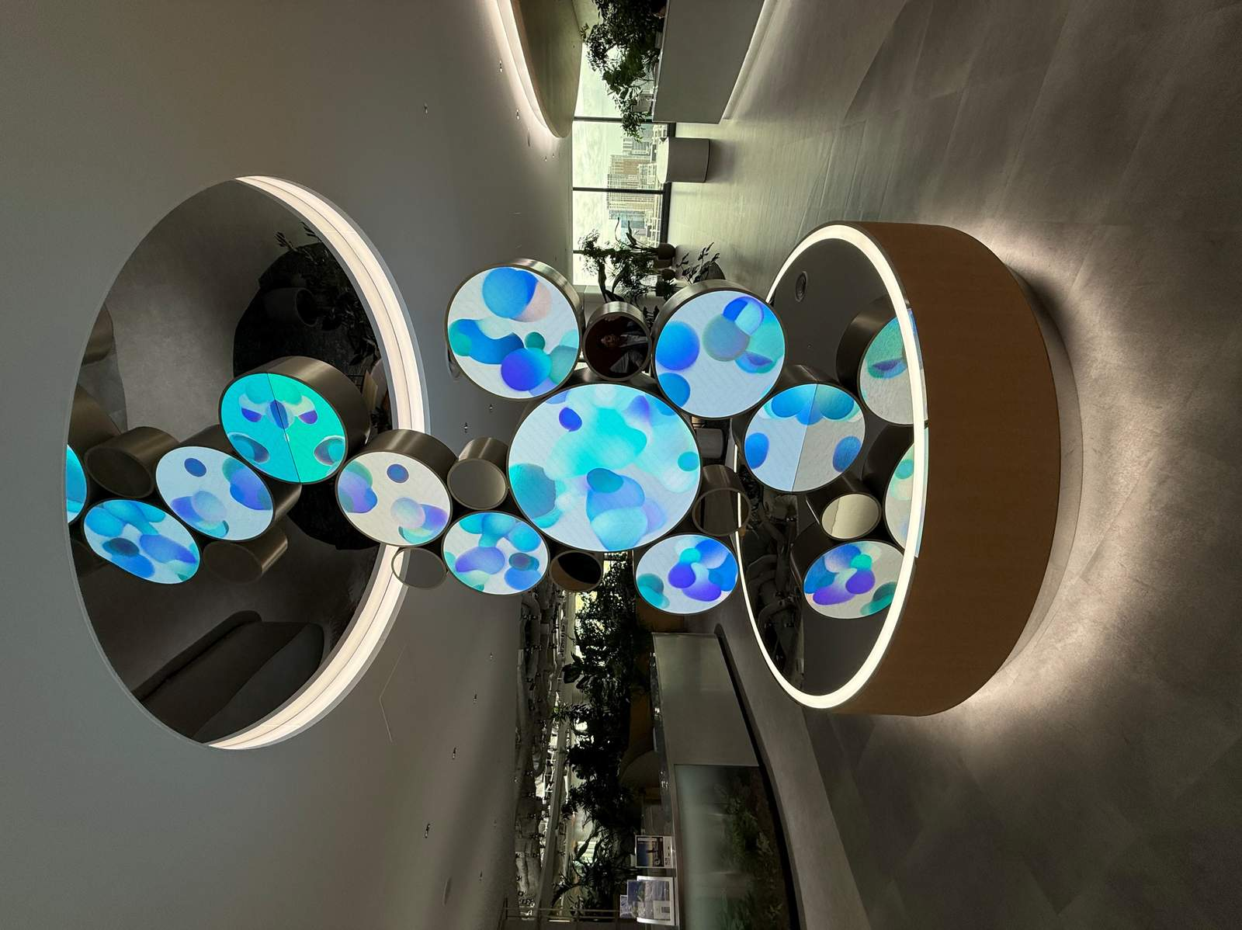
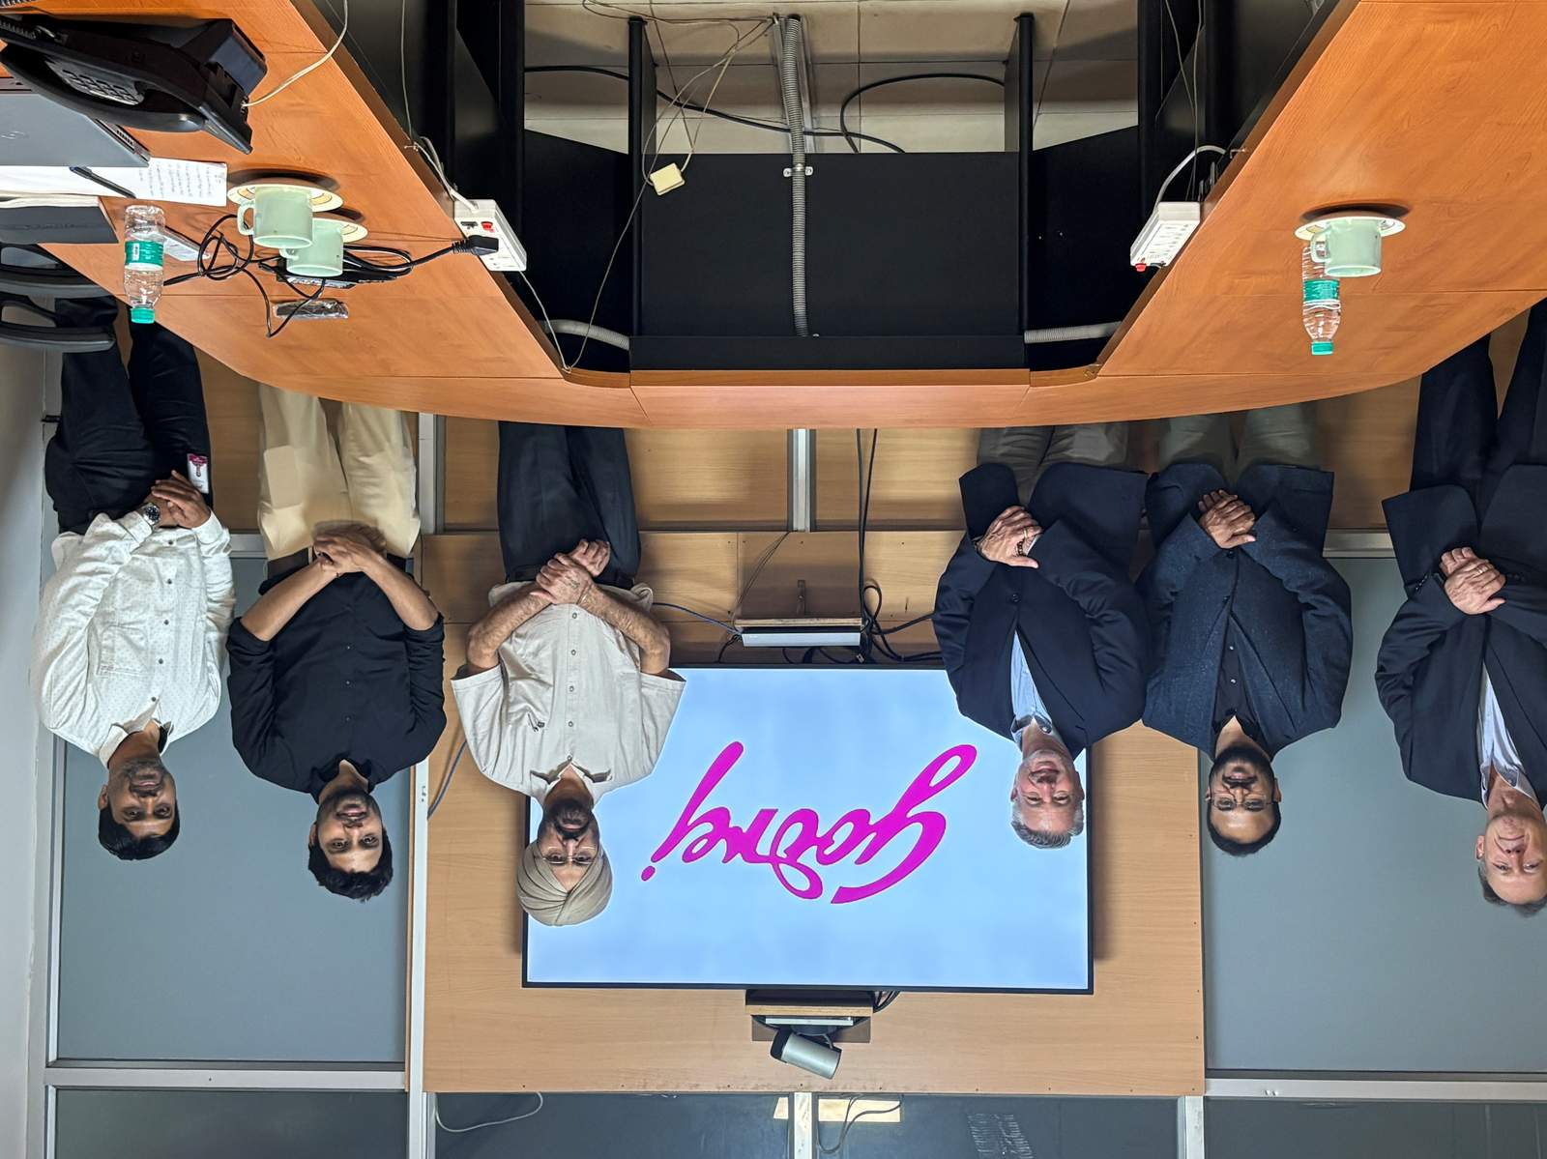
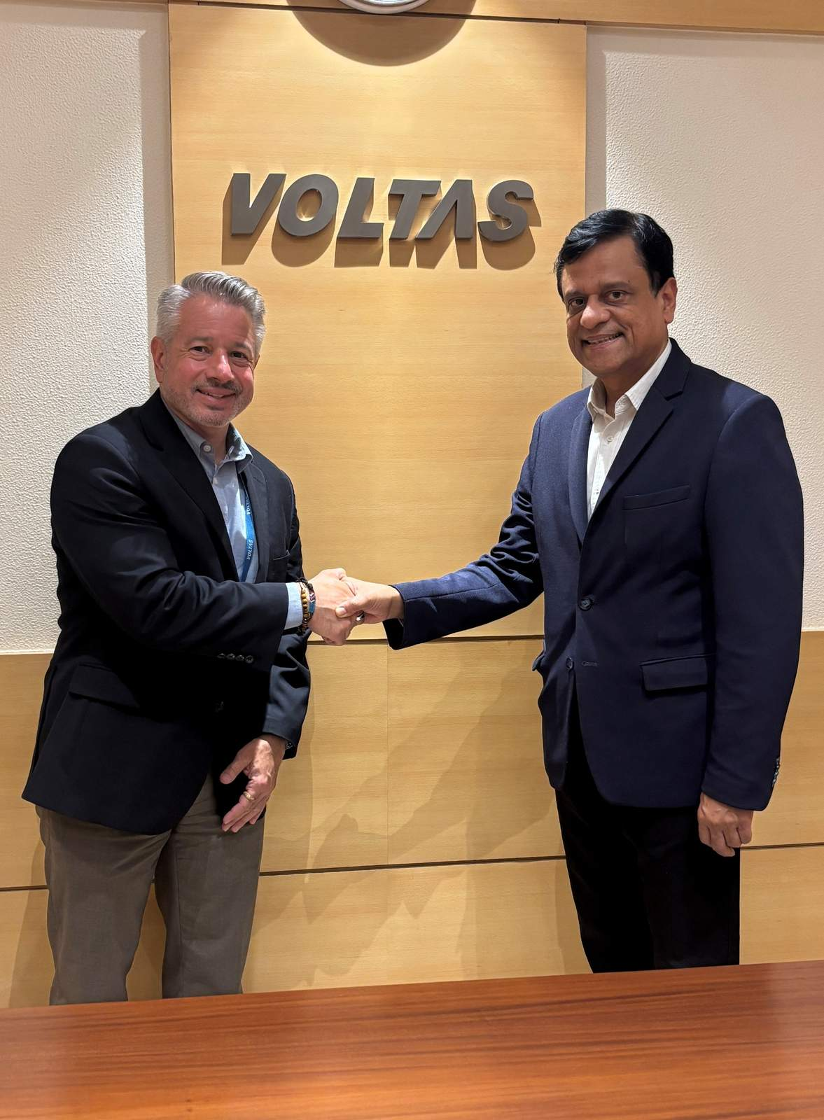
Notes:
Engagement with industry partners reinforced a consistent message: the need for stronger education in IEQ fundamentals, expanded workforce development, and practical guidance for owners and operators.
These conversations made one thing clear – no matter how well a building is designed, it cannot deliver healthy outcomes unless it is properly operated and maintained. There is an urgent need for practical checklists, resources, and training to assist building owners and operators in upholding high standards of IEQ. In the coming months, our focus will be on identifying existing resources and best practices, as well as developing new tools and training materials to be shared on the ASHRAE IEQ resource page.
All of this sets the stage for what comes next.

Slide 28
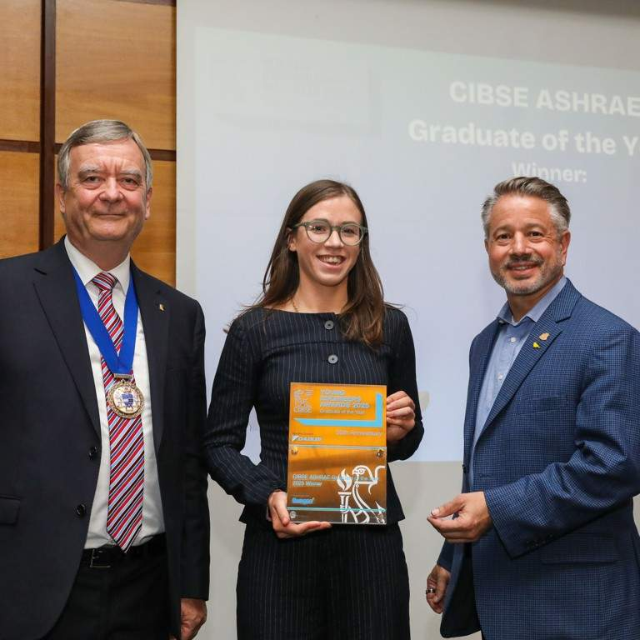



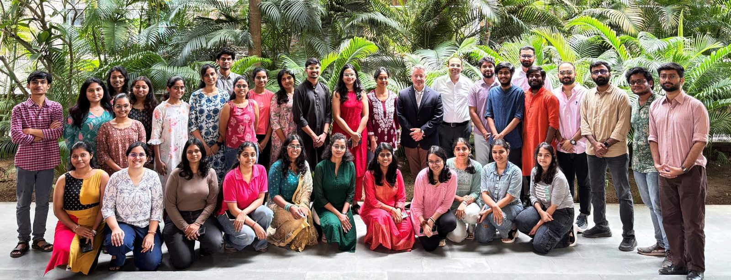
Notes:
Looking ahead, I will be visiting several chapters in all of the sixteen regions this spring with a priority on those that have not been recently visited by a President. We also have several major engagements on the horizon, including ACREX in Mumbai, India, China Refrigeration Expo in Beijing, China, the AIC conference in Kashi, India, and the ARBS Exposition in Melbourne, Australia. And of course. any opportunity to deepen collaboration with our global partners. ASHRAE is uniquely positioned to unite science, policy, and practice to accelerate IEQ solutions. We are answering the call for industry-wide collaboration to make healthy, resilient, low-energy buildings the global standard.

Slide 29



Notes:
As we conclude today, I want to express my sincere gratitude to each ASHRAE member, partner, and volunteer around the world. Your dedication and passion drive our mission forward, and together, we continue to shape the future of our built environment.
Let us reaffirm our commitment: healthy buildings are not just about better mechanical systems; they’re about better lives. Every step we take toward healthier indoor environments means we are investing in the well-being of our communities, our colleagues, and generations to come.
Looking ahead, let’s carry this spirit of collaboration and innovation with us. Together, we are designing for life, creating buildings that don’t just shelter us but sustain us, inspire us, and help us thrive. Thank you for your ongoing support and leadership. The work we do today will echo far into the future.
Thank you.

Slide 30

Thank you!
Visit ashrae.org/president

